Slide 1
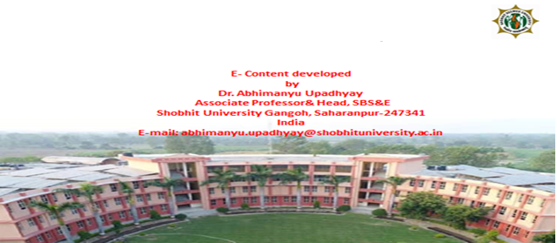
Presentation on
Strategic Management for
MBA-III Semester

Slide 2
Presentation on Strategic Management(SM)
Agenda:
What is Strategy?
Definition of Strategy
Features of Strategy
Levels of Strategy- corporate-level, business- level and functional-level.
What is Strategic Management?
Process of Strategic Management

Slide 3
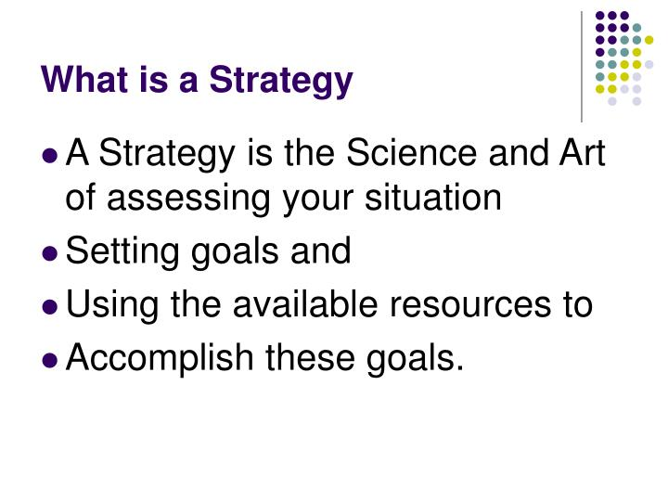
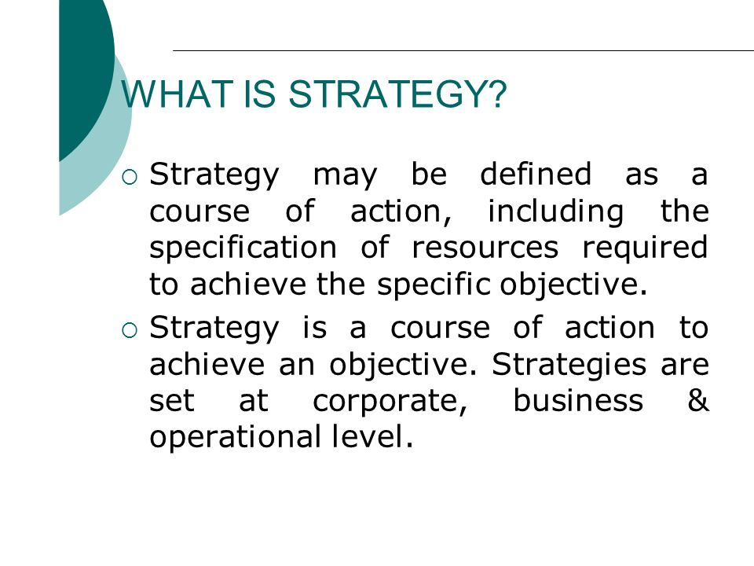
What is strategy?

Slide 4
Definition of Strategy
As per Glueck, Strategy is unified, comprehensive and integrated plan relating the strategic advantages of the firm to the challenges of the environment. It is designed to ensure that the basic objectives of the enterprise are achieved.
As per Alfred D. Chandler, Strategy is “The determination of basic long-term goals and objectives of an enterprise and the adoption of the courses of action and the allocation of resources necessary for carrying out these goals.”

Slide 5
Features of Strategy
Top management responsibility
Allocation of large amount of resources
Impact on long term prosperity of the firm
Future oriented
Multi-functional or multi-business consequences
Consideration of factors in the external environment

Slide 6
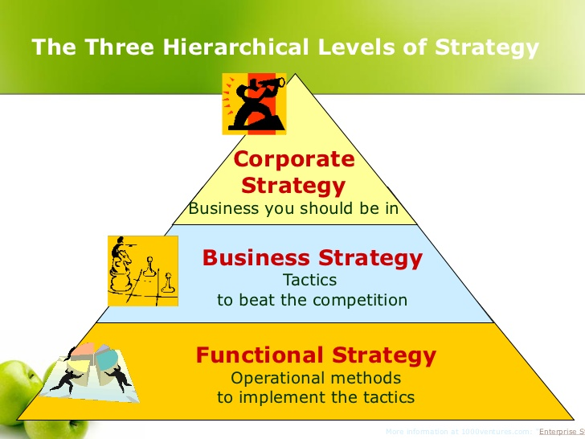
Levels of Strategy

Slide 7
Corporate-level Strategy:
• At this level, strategic decisions relate to organization-wide policies and are taken care by top-level management (BOD) with a vision of determining ‘Where the company wants to be?’
• It has two main aspects- Formulation of Strategy (strategic planning) and Strategy Implementation
• The nature of strategy at this level tend to be value-oriented, conceptual and than other levels.
• There is also greater risk, cost and profit potential as well as greater need of flexibility associated with this level.
• Major financial policy decisions involving acquisition, diversification and structural redesigning belong to this level.

Slide 8
Business-Level Strategy:
• Business-level strategy is more likely related to a unit within the whole. It is concerned with competition in a market.
• The concerns are about what products or services should be developed and offered to which markets in order to meet customer needs and organizational objectives.
• At this level, multifunctional strategies developed at corporate level are formulated and implemented for specific product market in which the business operates. Thus, managers at this level translate general directions and intent into concrete functional objectives.
• Decisions at this level include policies involving new product development, marketing mix, research & development, personnel, etc.

Slide 9
Functional/Operational-Level Strategy:
• Functional strategy involves decision-making with respect to specific functional areas- production, marketing, personnel, finance etc.
• While corporate and business level strategies are concerned with “Doing the right things”, functional strategies stress on “Doing things right”.
• Operating level strategy is concerned with strategic approaches for managing frontline operating units(like plants, sales, etc) and for handling day to day tasks of strategic significance(like advertising campaign, purchasing materials, inventory control, maintenance, etc.).
• Thus, functional level strategic management is the management of relatively narrow areas of activity, which are of vital, pervasive or continuing importance to the total organization.

Slide 10
Strategic Management
• Strategic management is a set of management decisions and actions that determines the long-run performance of a corporation. It includes environmental scanning, strategy formulation, strategy implementation and evaluation and control to achieve the objectives of an organization.
• The study of strategic management emphasizes the monitoring and evaluating of external opportunities and threats in light of a corporation’s strengths and weaknesses.
• As per Fred R. David, strategic management is an art and science of formulating, implementing and evaluating cross functional decisions that enable an organization to achieve its objectives.
• As per Channon, strategic management is defined as that set of decisions and actions that result in formulating of strategy an its implementation to achieve the objectives of the corporation.

Slide 11
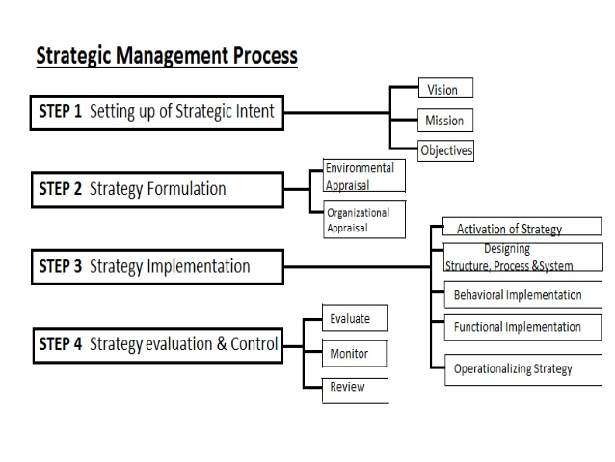

Slide 12
Step 1: Strategic Intent
Vision- Vision is the statement that expresses organization’s ultimate long-run objectives. It is what the firm ultimately like to become. Vision once formulated is for forever and long lasting for years to come. E.g.- Microsoft- ’A computer software on every desk and in every home’.
Mission- It tells who we are and what we do as well as what we’d like to become. Mission of a business is the fundamental, unique purpose that sets it apart from other firms of its kind and identifies the scope of its operations in product and market terms. E.g.- Microsoft- ‘Empower every person and every organization on the planet to achieve more’.
Objectives- Objectives state specifically how the goals shall be achieved. Following are the areas for setting objectives- profit objective, marketing objective, production objective, etc.

Slide 13
Step 2: Strategy Formulation
Strategy formulation refers to the process of choosing the most appropriate course of action for the realization of organizational goals and objectives and thereby achieving the organizational vision.
For choosing most appropriate course of action, appraisal of organization and environmental is done with the help of SWOT analysis.
• Environmental Appraisal- The environment of any organization is "the aggregate of all conditions, events and influences that surround and affect it". It is dynamic and consists of External & Internal Environment .
• Organizational Appraisal- It is the process of observing an organizational internal environment to identify the strengths and weaknesses that may influence the organization's ability to achieve goals. The analysis of corporate capabilities and weaknesses becomes a pre-requisite for successful formulation and reformulation of corporate

Slide 14
Step 3:Strategy Implementation
Strategy implementation is the action stage of strategic management. It refers to decisions that are made to install new strategy or reinforce existing strategy.
  • Designing structure, process & system- Strategy implementation includes the making of decisions with regard to organizational structure, developing budgets, programs and procedures in order to accomplish certain activities.
  • Functional Implementation- Functional implementation is carried out through functional plan and policies in five different areas- marketing, finance, operation, personnel and Information management
  • Behavioural Implementation- It denotes mobilizing employees and managers to put and formulate strategies into action and require personal discipline, commitment and sacrifice. It depends upon manager’s ability to motivate employees.
  • Operationalizing strategy- It includes establishing annual objectives, devising policies, and allocating resources.

Slide 15
Step 4.Strategy Evaluation & Control
• Strategy evaluation- It is the primary means to know when and why particular strategies are not working well. It is the process in which corporate activities and performance results are monitored so that actual performance can be compared with desired performance. Thus strategic evaluation activities include reviewing external and internal factors that are the basis for current strategies.
• Strategic control- In this step, organizations Determine what to control i.e., which objectives the organization hopes to accomplish, set control standards, measure performance, Compare the actual with the standard, determine the reasons for the deviations and finally taking corrective actions and review the policies and activities if needed.

Slide 16
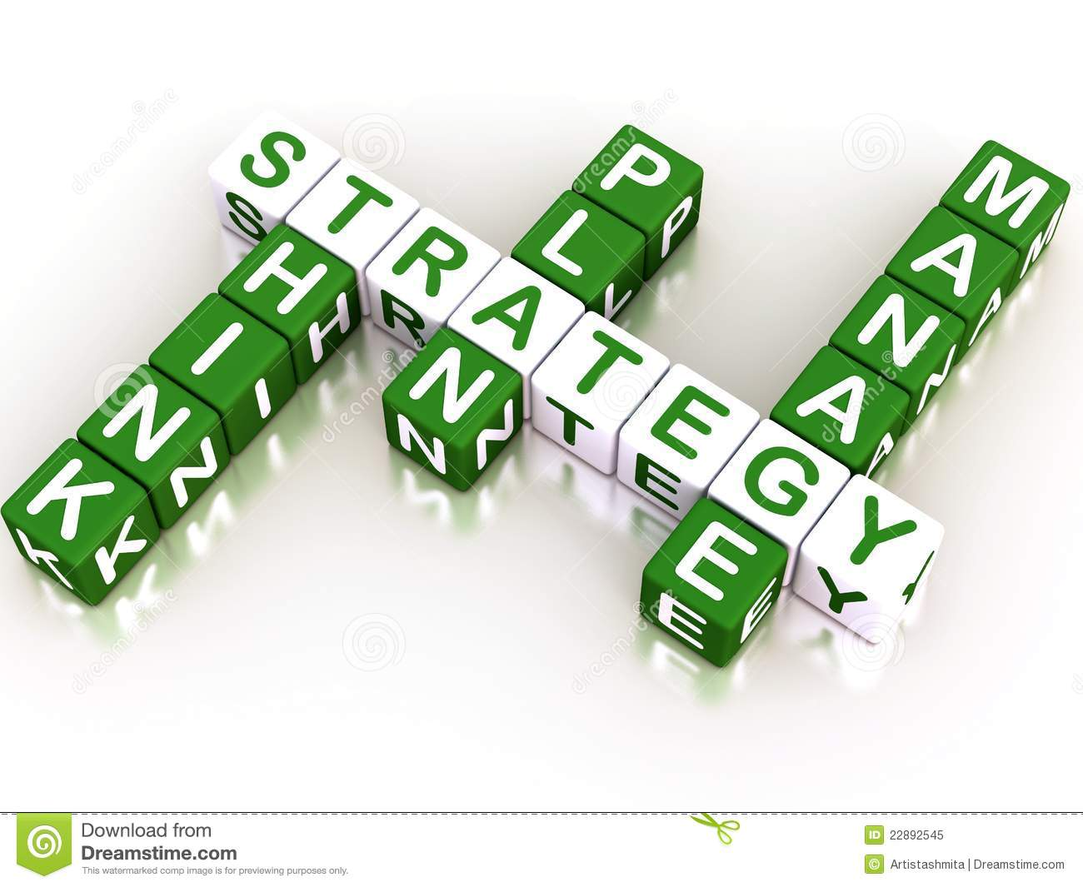
---without a strategy a business firm will not have a long term direction…
---Thank You For Your Attention

