Slide 1
Shobhit University Gangoh School Of Engineering and technology FUNDAMENTALS OF COMPUTER AND INFORMATION TECHNOLOGY
Presented By : Mr Nitin Kumar
(Assistant Professor(CSE))

Slide 2
What is Computer?
A computer is an electronic device, operating under the control of instructions stored in its own memory.
These instructions tell the machine what to do. The computer is capable of accepting data (input), processing data arithmetically and logically, producing output from the processing, and storing the results for future use.
Most computers that sit on a desktop are called Personal Computers (PCs).

Slide 3
Computer is an electronic machine that is used for storing, organizing, and finding words, numbers, and pictures, for doing calculations, and for controlling other machines:
a personal/home computer
All our customer orders are handled by computer.
We've put all our records on computer.
computer software/hardware
computer graphics
a computer program

Slide 4
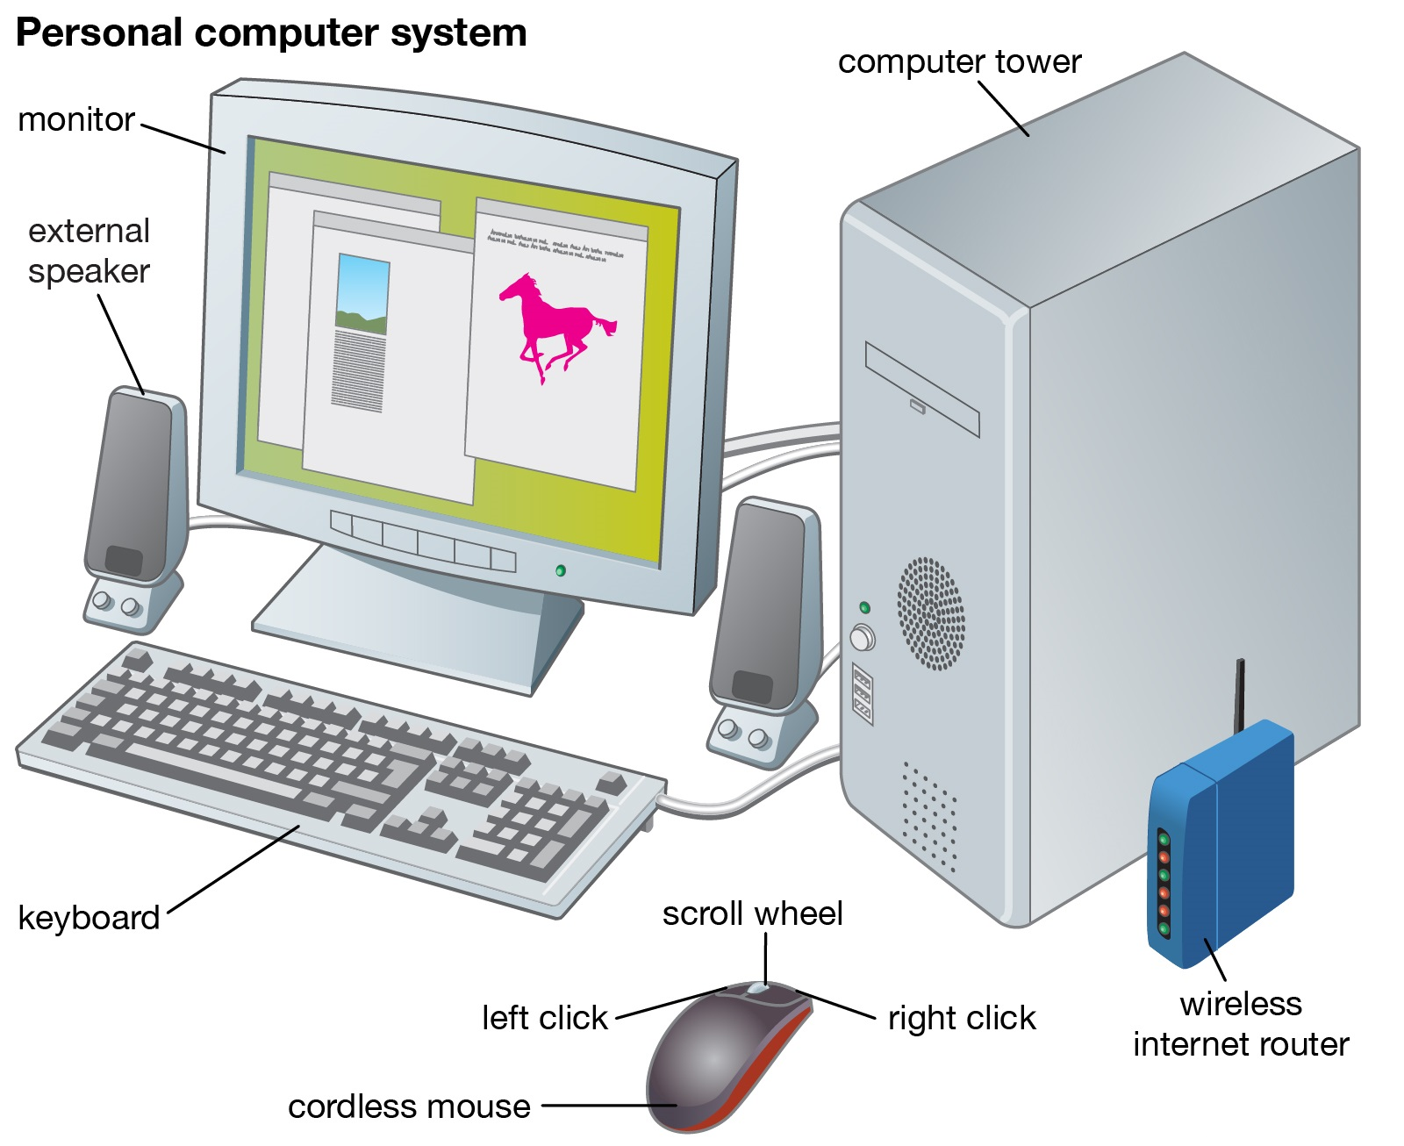

Slide 5
Functionalities of a Computer
If we look at it in a very broad sense, any digital computer carries out the following five functions: Step 1 - Takes data as input.
Step 2 - Stores the data/instructions in its memory and uses them as required.
Step 3 - Processes the data and converts it into useful information.
Step 4 - Generates the output.
Step 5 - Controls all the above four steps.

Slide 6
Advantages And Disadvantages Of Computer
Multitasking
Multitasking is one of the major advantage of computer. Person can perform multiple task, multiple operation, calculate numerical problems within few seconds. Computer can perform trillion of instructions per second.
Speed
Now computer is not just a calculating device. Now a day’s computer has very important role in human life. One of the main advantages of computer is its incredible speed, which helps human to complete their task in few seconds.

Slide 7
All the operations can be performed very fast just because of its speed elsewise it takes a long time to perform the task.
Cost/ Stores huge amount of data
It is a low cost solution. Person can save huge data within a low budget. Centralized database of storing information is the major advantage that can reduce cost.
Accuracy
One of the root advantage of computer is that can perform not only calculations but also with accuracy.

Slide 8
Data Security
Protecting digital data is known as data security. Computer provide security from destructive forces and from unwanted action from unauthorized users like cyber attack or access attack.

Slide 9
Disadvantage of Computer
Virus and hacking attacks
Virus is a worm and hacking is simply an unauthorized access over computer for some illicit purpose. Virus is being transferred from email attachment, viewing an infected website advertisement, through removable device like USB etc. once virus is transferred in host computer it can infect file, overwrite the file etc.

Slide 10
Online Cyber Crimes
Online cyber-crime means computer and network may have used in order to commit crime. Cyber stalking and Identity theft are the points which comes under online cyber-crimes. For example: one may get the access of the access to your shopping account like amazon account now that person will be able to know your personal details like debit card or credit card number which can be than misused.

Slide 11
Reduction in employment opportunity
Mainly past generation was not used of the computer or they have the knowledge of computer they faced a big problem when computer came in field. As we have seen in banking sector senior bank employees faced this problem when computer came to the banking sector. Above were the main disadvantage of computer, no IQ, Dependency, No feeling, Break down are the basic disadvantages of computer.

Slide 12
Computer - Applications
Business
A computer has high speed of calculation, diligence, accuracy, reliability, or versatility which has made it an integrated part in all business organizations.

Slide 13
Computer is used in business organizations for −
Payroll calculations
Budgeting
Sales analysis
Financial forecasting
Managing employee database
Maintenance of stocks, etc.

Slide 14
Banking
Today, banking is almost totally dependent on computers.
Banks provide the following facilities −
Online accounting facility, which includes checking current balance, making deposits and overdrafts, checking interest charges, shares, and trustee records.
ATM machines which are completely automated are making it even easier for customers to deal with banks.

Slide 15
Insurance
Insurance companies are keeping all records up-to-date with the help of computers. Insurance companies, finance houses, and stock broking firms are widely using computers for their concerns.
Insurance companies are maintaining a database of all clients with information showing −
Procedure to continue with policies
Starting date of the policies
Next due installment of a policy
Maturity date
Interests due
Survival benefits
Bonus

Slide 16
Education
The computer helps in providing a lot of facilities in the education system.
The computer provides a tool in the education system known as CBE (Computer Based Education).
CBE involves control, delivery, and evaluation of learning.
Computer education is rapidly increasing the graph of number of computer students.
There are a number of methods in which educational institutions can use a computer to educate the students.
It is used to prepare a database about performance of a student and analysis is carried out on this basis.

Slide 17
Marketing
In marketing, uses of the computer are following −
Advertising − With computers, advertising professionals create art and graphics, write and revise copy, and print and disseminate ads with the goal of selling more products.
Home Shopping − Home shopping has been made possible through the use of computerized catalogues that provide access to product information and permit direct entry of orders to be filled by the customers.

Slide 18
Healthcare
Computers have become an important part in hospitals, labs, and dispensaries. They are being used in hospitals to keep the record of patients and medicines. It is also used in scanning and diagnosing different diseases. ECG, EEG, ultrasounds and CT scans, etc. are also done by computerized machines.
Following are some major fields of health care in which computers are used.
Diagnostic System − Computers are used to collect data and identify the cause of illness.

Slide 19
Lab-diagnostic System − All tests can be done and the reports are prepared by computer.
Patient Monitoring System − These are used to check the patient's signs for abnormality such as in Cardiac Arrest, ECG, etc.
Pharma Information System − Computer is used to check drug labels, expiry dates, harmful side effects, etc.
Surgery − Nowadays, computers are also used in performing surgery.

Slide 20
Engineering Design
Computers are widely used for Engineering purpose.
One of the major areas is CAD (Computer Aided Design) that provides creation and modification of images. Some of the fields are −
Structural Engineering − Requires stress and strain analysis for design of ships, buildings, budgets, airplanes, etc.
Industrial Engineering − Computers deal with design, implementation, and improvement of integrated systems of people, materials, and equipment.

Slide 21
Architectural Engineering − Computers help in planning towns, designing buildings, determining a range of buildings on a site using both 2D and 3D drawings.

Slide 22
Military
Computers are largely used in defense. Modern tanks, missiles, weapons, etc. Military also employs computerized control systems. Some military areas where a computer has been used are −
Missile Control
Military Communication
Military Operation and Planning
Smart Weapons

Slide 23
Communication
Communication is a way to convey a message, an idea, a picture, or speech that is received and understood clearly and correctly by the person for whom it is meant. Some main areas in this category are −
E-mail
Chatting
Usenet
FTP
Telnet
Video-conferencing

Slide 24
Government
Computers play an important role in government services. Some major fields in this category are −
Budgets
Sales tax department
Income tax department
Computation of male/female ratio
Computerization of voters lists
Computerization of PAN card
Weather forecasting

Slide 25
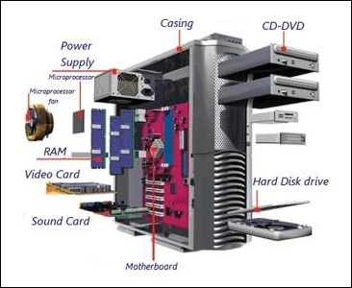
Computer Hardware And Software
Hardware
The term hardware refers to mechanical device that makes up computer. Computer hardware consists of interconnected electronic devices that we can use to control computer’s operation, input and output. Examples of hardware are CPU, keyboard, mouse, hard disk, etc.

Slide 26
Hardware Components
Computer hardware is a collection of several components working together. Some parts are essential and others are added advantages. Computer hardware is made up of CPU and peripherals as shown in image below.

Slide 27
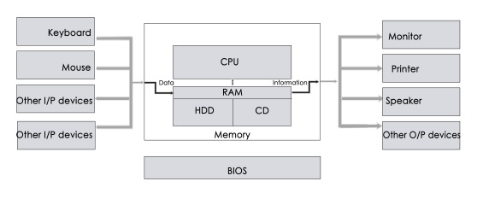

Slide 28
Software
A set of instructions that drives computer to do stipulated tasks is called a program. Software instructions are programmed in a computer language, translated into machine language, and executed by computer. Software can be categorized into two types −
System software
Application software

Slide 29
System Software
System software operates directly on hardware devices of computer. It provides a platform to run an application. It provides and supports user functionality. Examples of system software include operating systems such as Windows, Linux, Unix, etc.

Slide 30
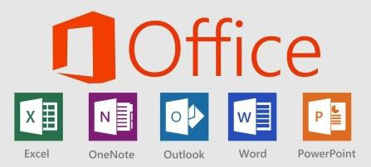
Application Software
An application software is designed for benefit of users to perform one or more tasks. Examples of application software include Microsoft Word, Excel, PowerPoint, Oracle, etc.

Slide 31
THANK YOU

