Slide 1



BBA I Semester
Micro Economics
Topic- Monopolistic competition
Adesh Kumar
Assistant Professor,
SBS&E
(Shobhit University), Gangoh, India
E-mail: adesh.kumar@shobhituniversity.ac.in

Slide 2

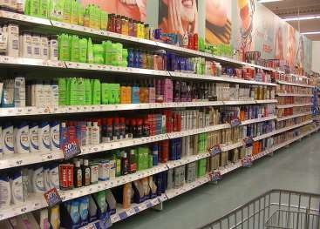


Monopolistic Competition

Slide 3
Monopolistic Competition
It is a market situation in which a relatively large number of producers offer similar but not identical products.
Monopolistic competition refers to a market situation in which there are large number of firms which sell closely related but differentiated products .

Slide 4
Monopolistic Competition : Definition
Monopolistic competition refers to competition among a large number of sellers of similar but differentiated products , which are close substitutes but not perfect substitutes of one another.

Slide 5

Monopolistic Competition: Features
Many Sellers/ Large Number Of firms.
.
There are large number of firm selling closely related but not homogenous products.

Slide 6


Free Entry or Exit
Firms can enter or exit the market without restriction.
The number of firms in the market adjusts until economic profits are zero.

Slide 7
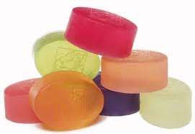
Product Differentiation
Firms can set price at a level higher than the price established by perfect competition.
Product of one producer is differentiated with the product of other producer, having close substitutes.
For example –Bathroom soaps:- Hamam, Lux, Rexona, Cinthol, Lifebuoy, etc.

Slide 8

Independent Price Policy
A firm under monopolistic competition can influence the price of the commodity to some extent.
This is because of the availability of close substitutes of
the products in monopolistic competition.

Slide 9
Selling cost :- selling cost refers to the expenses incurred on marketing ,sales promotion and advertising of the product

Slide 10
Lack of perfect knowledge :-
Buyers and sellers do not have perfect knowledge about the market condition.

Slide 11


