Slide 1

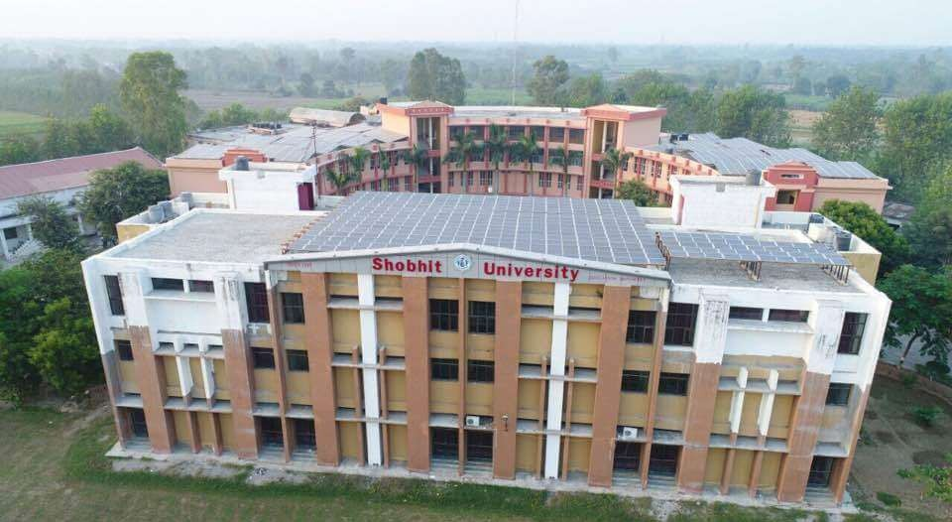
Fundamentals of Financial Management
BBA V Semester
Topic- Inventory Management
Mr. Rahul Kumar
Assistant Professor,
SBS&E
(Shobhit University), Gangoh, India
E-mail: rahul.kumar@shobhituniversity.ac.in

Slide 2




What is Inventory?
A physical resource that a firm holds in stock with the intent of selling it or transforming it into a more valuable state
Purpose of inventory management:
  How many units to order
  When to order
  When to return or replace

Slide 3
Reasons We Keep Inventory
Improve customer service
Maintain independence of the supply chain
Bullwhip effect
Seasonal or cyclical demand
Hedge against the future (demand, price volatility…)
Inventory provides independence from vendors
Take advantage of price discounts
Transportation discounts
Protection from shocks (labor strikes, natural disasters, surges in demand, etc.)

Slide 4
Reasons We Keep Inventory
Adding value through inventory:
Quality – Inventory can act as a buffer against poor quality.
Speed – Location of inventory can have a significant impact on fulfilling customer demand
Flexibility – Location and level of anticipatory inventory
directly effect the firm’s flexibility to meet demand
Cost – Direct effect: purchasing, delivery, manufacturing Indirect: inventory holding costs, stockouts

Slide 5

What is Inventory Management?
Inventory management is the process of keeping track of inventory, and having the delicate balance of supply and demand firmly mastered.
Inventory management helps to ensure that proper inventory is maintained at all times.
Inventory costs money. Therefore, a company does not want to have too much inventory or too little inventory.
Inventory Management must be designed to meet the dictates of the
marketplace and support the company's strategic plan.
Properly executed, inventory management helps ensure the company will have exactly the amount of inventory needed.

Slide 6

Inventory Management
The basic building blocks of inventory management are:
Sales Forecasting/Demand Management Sales and Operations Planning Production Planning
Material Requirements Planning
Inventory Reduction

Slide 7

Inventory and Quality Management
Customers usually perceive quality service as the availability of goods they want when they want them
Inventory must be sufficient in both quantity and quality to provide high-quality customer service

Slide 8

Objectives of Inventory Control
Maximize the level of customer service by avoiding stockouts
Promote efficiency in production and purchasing by minimizing the cost associated with providing an adequate level of customer service

Slide 9

Inventory Costs
Carrying cost
cost of holding an item in inventory
Ordering cost
cost of replenishing inventory
Shortage cost
temporary or permanent loss of sales when demand cannot be met

Slide 10

Economic Order Quantity (EOQ) Models
Economic order quantity (EOQ) is the ideal order quantity a company should purchase to minimize inventory costs such as holding costs, shortage costs, and order costs. This production-scheduling model was developed in 1913 by Ford W. Harris and has been refined over time. The formula assumes that demand, ordering, and holding costs all remain constant.
EOQ
optimal order quantity that will minimize
total inventory costs
Basic EOQ model
Production quantity model

Slide 11
Assumptions of Basic EOQ Model
Demand is known with certainty and is constant over time
No shortages are allowed
Lead time for the receipt of orders is constant Order quantity is received all at once

Slide 12
Safety Stock
Safety stock
buffer added to on hand inventory during lead time
Stockout
an inventory shortage
Service level
probability that the inventory which is available during lead
time will meet demand

Slide 13

Classifying Inventory Items
ABC(Always better Control) Classification
A Items – very tight control, complete and accurate records, frequent review
B Items – less tightly controlled, good records, regular review
C Items – simplest controls possible, minimal records, large inventories, periodic review

