Slide 1
SHOBHIT UNIVERSITY, GANGOH
DEPARTMENT OF COMPUTER SCIENCE AND ENGINEERING
SUBJECT-MANAGEMENT INFORMATION SYSTEM
TOPIC- ELECTRONIC COMMERCE
Prepared By: Mr. Kuldeep Chauhan

Slide 2
ELECTRONICS COMMERCE
E-Commerce or Electronics Commerce is a methodology of modern business, which addresses the need of business organizations, vendors and customers to reduce cost and improve the quality of goods and services while increasing the speed of delivery. Ecommerce refers to the paperless exchange of business
information using the following ways −
Electronic Data Exchange (EDI)
Electronic Mail (e-mail)
Electronic Bulletin Boards
Electronic Fund Transfer (EFT)

Slide 3
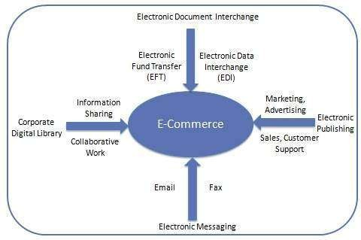

Slide 4
FEATURES
Non-Cash Payment − E-Commerce enables the use of credit cards, debit cards, smart cards, electronic fund transfer via bank's website, and other modes of electronics payment.
24x7 Service availability − E-commerce automates the business of enterprises and the way they provide services to their customers. It is available anytime, anywhere.
Advertising / Marketing − E-commerce increases the reach of advertising of products and services of businesses. It helps in better marketing management of products/services.

Slide 5
Improved Sales − Using e-commerce, orders for the products can be generated anytime, anywhere without any human intervention. It gives a big boost to existing sales volumes.
Support − E-commerce provides various ways to provide pre-sales and post-sales assistance to provide better services to customers.
Inventory Management − E-commerce automates inventory management. Reports get generated instantly when required. Product inventory management becomes very efficient and easy to maintain.
Communication improvement − E-commerce provides ways for faster, efficient, reliable communication with customers and partners.

Slide 6
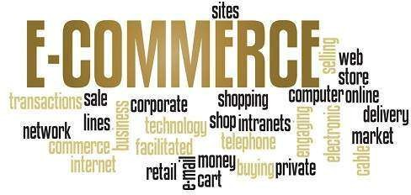

Slide 7
ADVANTAGES TO ORGANIZATIONS
Using e-commerce, organizations can expand their market to national and international markets with minimum capital investment. An organization can easily locate more customers, best suppliers, and suitable business partners across the globe.
E-commerce helps organizations to reduce the cost to create process, distribute, retrieve and manage the paper based information by digitizing the information.
E-commerce improves the brand image of the company.
E-commerce helps organization to provide better
customer services.
E-commerce helps to simplify the business processes and makes them faster and efficient.

Slide 8
E-commerce reduces the paper work.
E-commerce increases the productivity of organizations. It supports "pull" type supply management. In "pull" type supply management, a business process starts when a request comes from a customer and it uses just-in-time manufacturing way.

Slide 9
ADVANTAGES TO CUSTOMERS
It provides 24x7 support. Customers can enquire about a product or service and place orders anytime, anywhere from any location.
E-commerce application provides users with more options and quicker delivery of products.
E-commerce application provides users with more options to compare and select the cheaper and better options.
A customer can put review comments about a product and can see what others are buying, or see the review comments of other customers before making a final purchase.

Slide 10
E-commerce provides options of virtual auctions.
It provides readily available information. A customer can see the relevant detailed information within seconds, rather than waiting for days or weeks.
E-Commerce increases the competition among organizations and as a result, organizations provides substantial discounts to customers.

Slide 11
ADVANTAGES TO SOCIETY
Customers need not travel to shop a product, thus less traffic on road and low air pollution.
E-commerce helps in reducing the cost of products, so less affluent people can also afford the products.
E-commerce has enabled rural areas to access services and products, which are otherwise not available to them.
E-commerce helps the government to deliver public services such as healthcare, education, social services at a reduced cost and in an improved manner.

Slide 12
E-COMMERCE BUSINESS MODELS
E-commerce business models can generally be
categorized into the following categories.
Business - to - Business (B2B)
Business - to - Consumer (B2C)
Consumer - to - Consumer (C2C)
Consumer - to - Business (C2B)

Slide 13
BUSINESS - TO - BUSINESS
A website following the B2B business model sells its products to an intermediate buyer who then sells the product to the final customer. As an example, a wholesaler places an order from a company's website and after receiving the consignment, sells the end product to the final customer who comes to buy the product at one of its retail outlets.

Slide 14
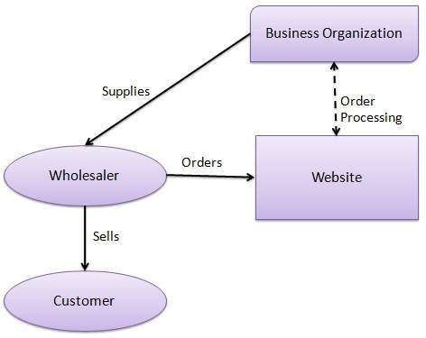

Slide 15
BUSINESS - TO - CONSUMER
A website following the B2C business model sells its products directly to a customer. A customer can view the products shown on the website. The customer can choose a product and order the same. The website will then send a notification to the business organization via email and the organization will dispatch the product/goods to the customer.

Slide 16
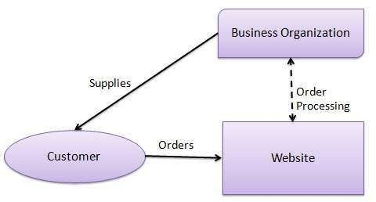

Slide 17
CONSUMER - TO - CONSUMER
A website
following the C2C business model
helps consumers to sell their assets like residential property, cars, motorcycles, etc., or rent a room by publishing their information on the website. Website may or may not charge the consumer for its services. Another consumer may opt to buy the product of the first customer by viewing the post/advertisement on the website.

Slide 18
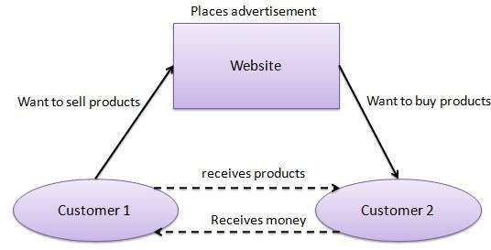

Slide 19
CONSUMER - TO - BUSINESS
In this model, a consumer approaches a website showing multiple business organizations for a particular service. The consumer places an estimate of amount he/she wants to spend for a particular service. For example, the comparison of interest rates of personal loan/car loan provided by various banks via websites. A business organization who fulfills the consumer's
requirement approaches services.
within the specified
budget,
the customer and provides its

Slide 20
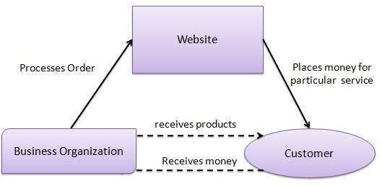

Slide 21
ASSIGNMENT QUESTIONS
Q1: What do you mean by an e-commerce?
Q2: E-commerce is the future of upcoming market activities? Explain the maxim in your own words.

