Slide 1


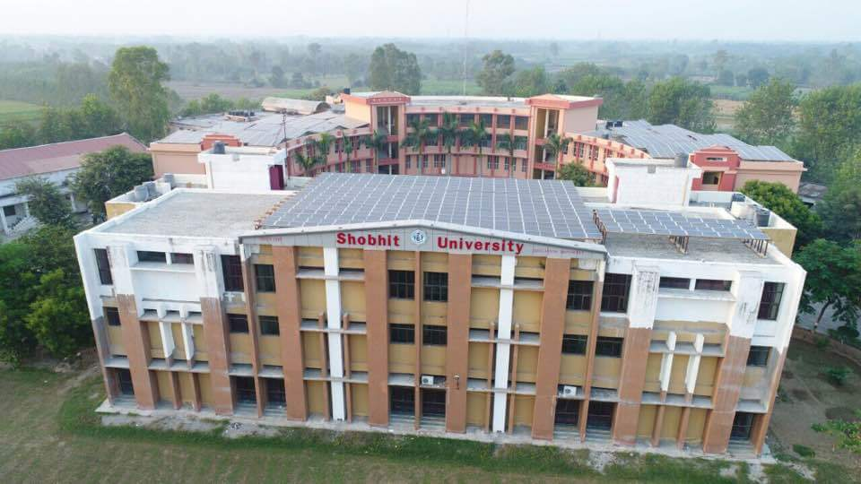
BBA VI Semester
Goods & Service Tax
Adesh Kumar
Assistant Professor,
SBS&E
(Shobhit University), India
E-mail: adesh.kumar@shobhituniversity.ac.in

Slide 2
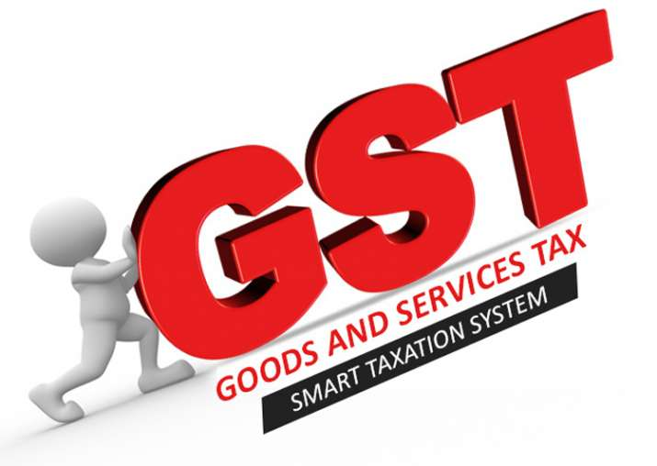

Slide 3
GST as Indirect Tax
With the implementation of GST, we have already witnessed a number of positive changes in the fiscal domain of India. The various taxes that were mandatory earlier are now obsolete.
GST is making sure the slogan “One Nation, One Tax, One Market” becomes the reality of our country and not just a dream.
With ‘Goods & Services Tax (GST), the biggest relief so far is clearly the elimination of the ‘cascading effect of tax’ or the ‘tax on tax’.
Cascading effect of tax is a situation wherein the end-consumer of any goods or service has to bear the burden of the tax to be paid on the previously calculated tax and as a result would suffer an increased or inflated price.

Slide 4
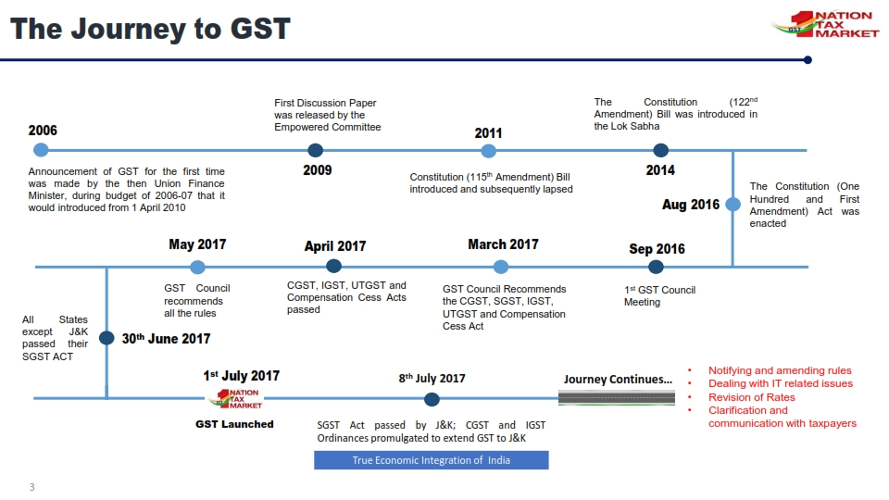

Slide 5
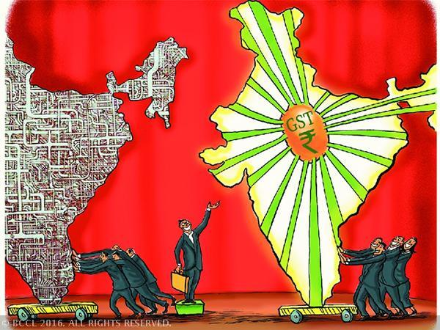
What is GST?
One Tax For
Manufacturing
Trading
Services
ONE NATION: ONE TAX
Notes:
Whether you are manufacturer, trader, dealer, service supplier- all will be considered as same i.e taxpayer. Whether you supply within the same state or anywhere in the country, the rate of tax is same, thereby obviating any need for various forms and border check points which is prevalent today.

Slide 6
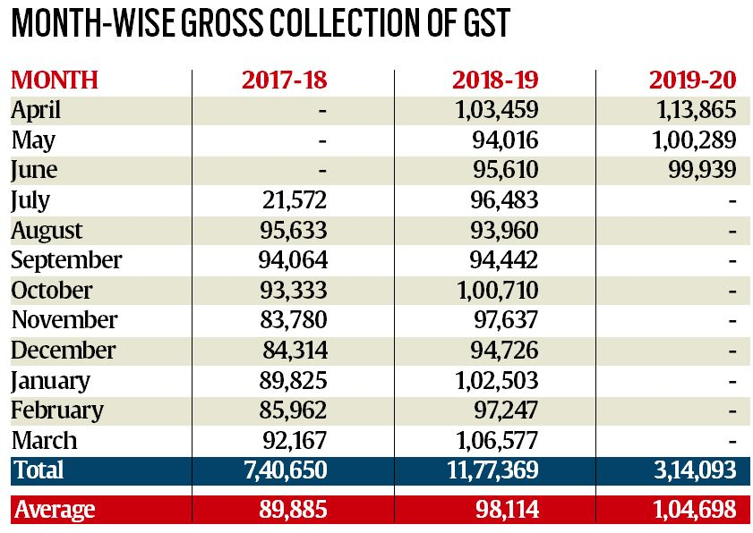
Notes:
Whether you are manufacturer, trader, dealer, service supplier- all will be considered as same i.e taxpayer. Whether you supply within the same state or anywhere in the country, the rate of tax is same, thereby obviating any need for various forms and border check points which is prevalent today.

Slide 7
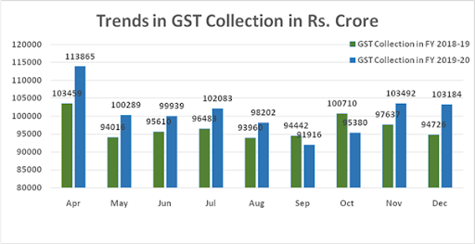
Notes:
Whether you are manufacturer, trader, dealer, service supplier- all will be considered as same i.e taxpayer. Whether you supply within the same state or anywhere in the country, the rate of tax is same, thereby obviating any need for various forms and border check points which is prevalent today.

Slide 8
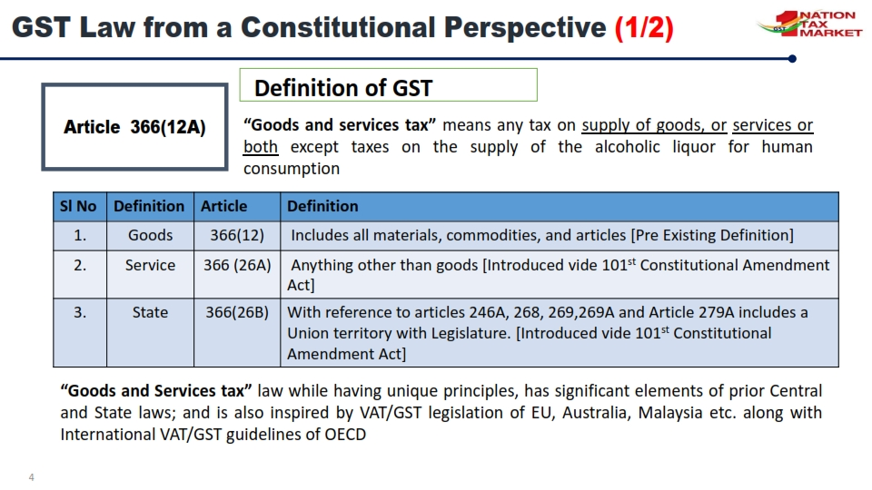

Slide 9
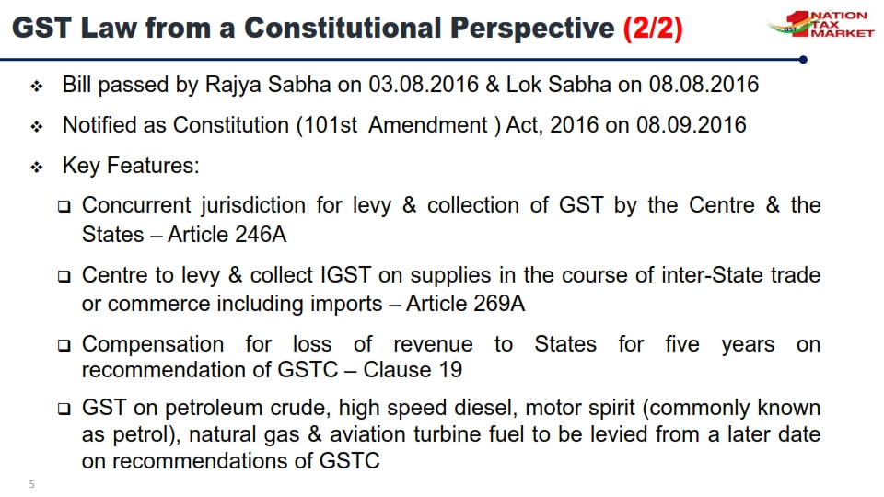

Slide 10
Main Features of the GST Act
Concurrent jurisdiction for levy & collection of GST by the Centre (CGST) and the States (SGST)
Centre to levy and collect IGST on supplies in the course of inter- State supplies & imports
Compensation for loss of revenue to States for five years
All transactions and processes only through electronic mode – Non- intrusive administration
PAN Based Registration
Input Tax Credit available on taxes paid on all procurements (except few specified items)

Slide 11
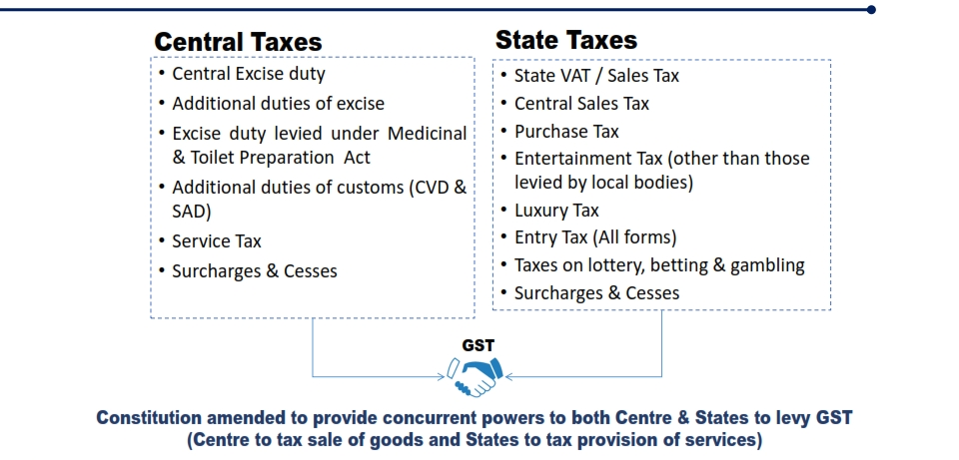
Tax Structure in India Before GST

Slide 12
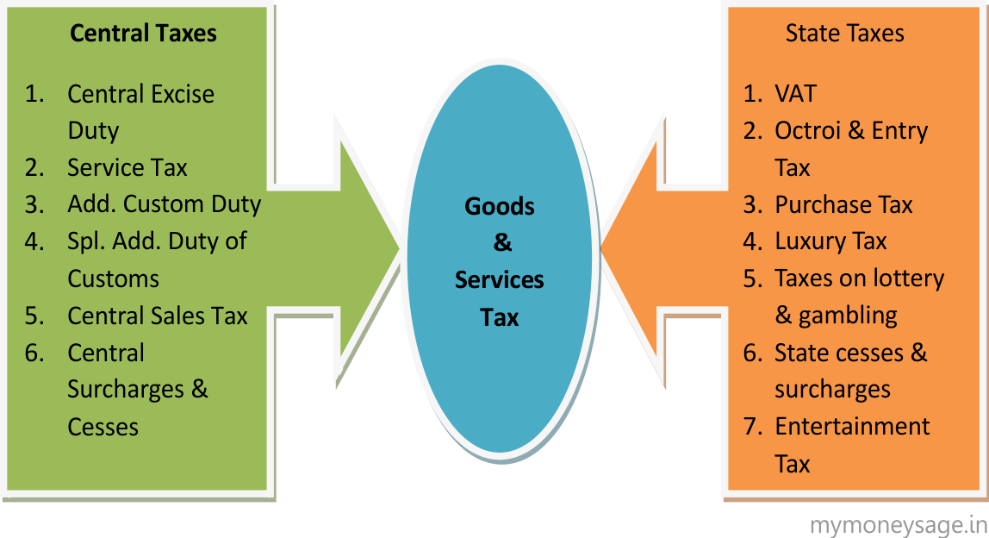

Slide 13
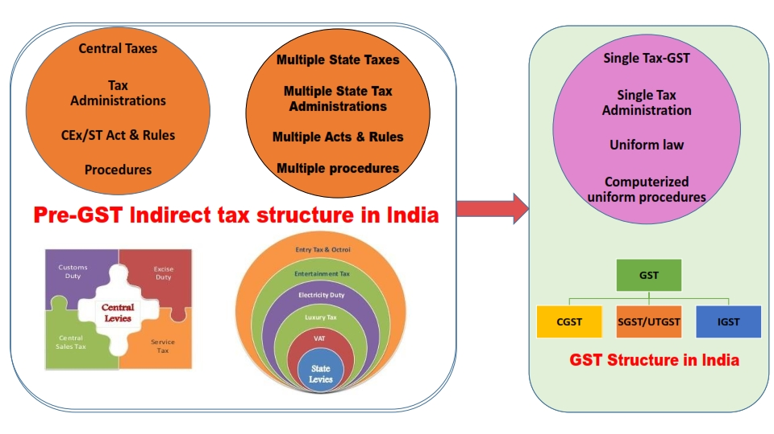
Tax Structure in India Before GST

Slide 14
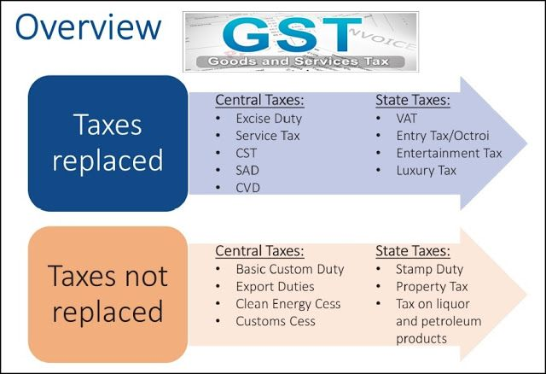

Slide 15
GST
GST is applicable on “supply” of goods or services as against the present concept of tax on manufacture of goods or on sale of goods or on provision of services.
GST is based on the principle of destination based consumption taxation as against the Previous principle of origin-based taxation.
It would be a dual GST with the Centre and the States simultaneously levying it on a common base. The GST to be levied by the Centre would be called Central GST (central tax- CGST) and that to be levied by the States [including Union territories with legislature] would be called State GST (state tax- SGST). Union territories without legislature would levy Union territory GST (union territory tax- UTGST).
An Integrated GST (integrated tax- IGST) would be levied on inter-State supply (including stock transfers) of goods or services. This would be collected by the Centre so that the credit chain is not disrupted.

Slide 16
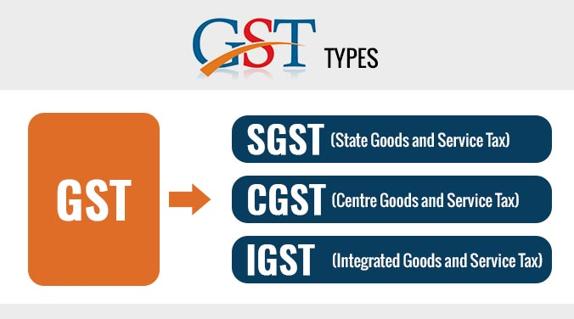

Slide 17
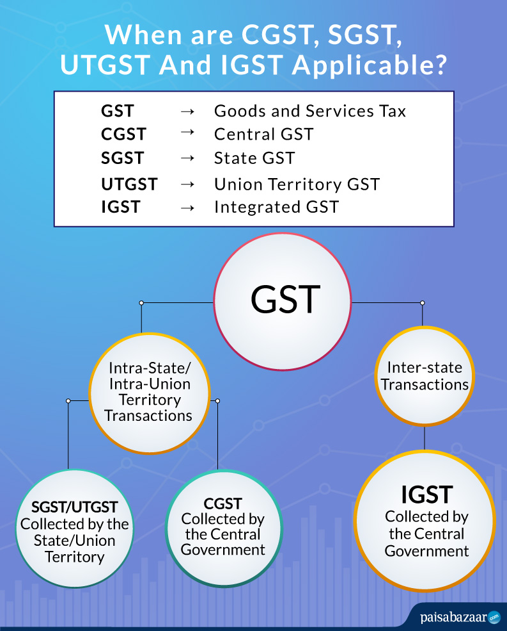

Slide 18
Calculation of Taxes
SOURCE | DESTINATION | GST TYPE
State | Same State | CGST+SGST
State | Different State | IGST
Union Territory | Same U.T. | CGST+ UTGST
Union Territory | Different U.T. | IGST

Slide 19
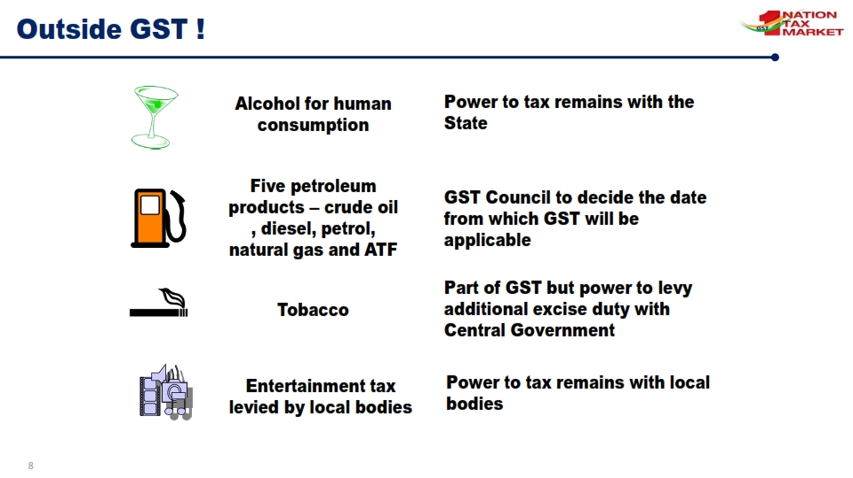
What is not under GST

Slide 20
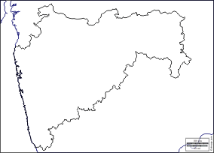
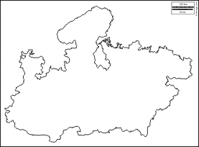
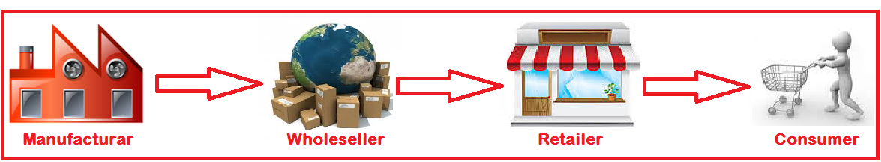
Limitations of Previous Tax regime
1. Cascading Effect of Tax
MAHARASHTRA
MADHYA PRADESH
Credit of CST Not Available (This should relate to interstate supply. An arrow can be shown from wholesaler in Maharashtra to retailer in Madhya Pradesh and show that credit of CST paid in Mah. not available to Retailer in MP)
Credit of Excise not allowed
Notes:
The present existing tax regime is grossly inefficient with breakage of input tax chain at multiple stages resulting in tax being imposed on tax which is commonly termed as cascade of taxes. All this adds to the costs of a product and results in tendency to avoid paying taxes by using all possible means.

Slide 21
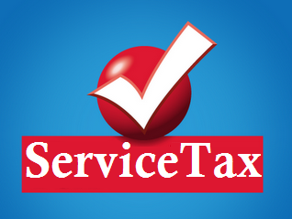



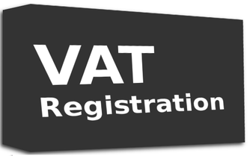
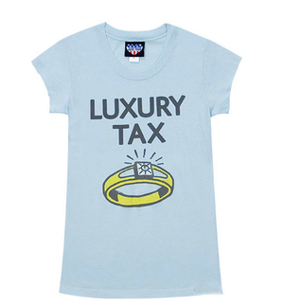

Limitations of Previous Tax regime
2. Multiple Registrations
Central Excise
Notes:
Multiple laws require multiple compliances and registrations with no interlinkages amongst them leading to silos being created. In many cases, these different governments- Centre, states are trying to tax same transactions.

Slide 22

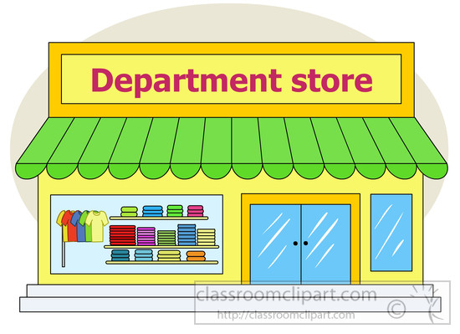

Limitations of Previous Tax regime
3. Different Points of Taxation
Limitations of current Tax regime :
Central Excise
(On Manufacturing)
Service Tax
(On provision of Service)
VAT
( On sale of Goods)
Notes:
There are different taxable events with each having issues of definitions, interpretations resulting in overlapping at many places. All this creates confusions with many of the issues reaching courts for a decisions.

Slide 23
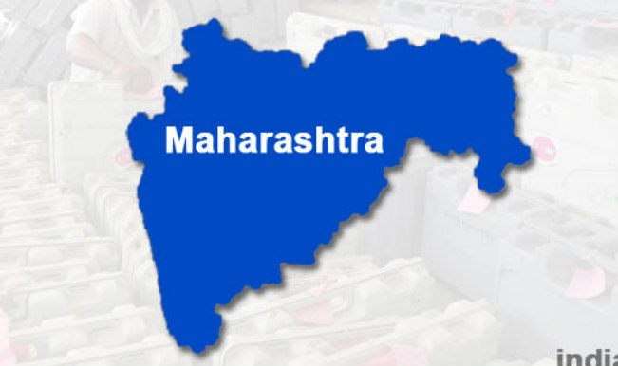
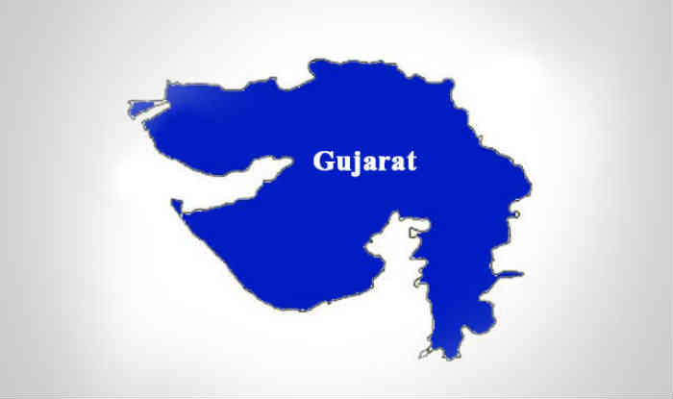
Limitations of Previous Tax regime
4. Lack of Uniformity
No Entry Tax
Entry Tax
@ NIL %
@ 4%
Value Added Tax
e.g. on Sugar
Notes:
Harmonisation in the different taxation laws of states appears to be missing many a times. Uniformity is lacking while levying VAT or entry taxes in many states. The companies try to take advantage of tax arbitrages leading to decisions being taken on the basis of tax structure rather than on the basis of pure economic reasons. All this leads to inefficiencies in the system.

Slide 24



Limitations of current Tax regime :
Limitations of Previous Tax regime
5. Goods Vs. Services dilemma ?
License Software in CD
Sale of Food In Restaurant
Sale
Services
Manufacturing
Notes:
There is a concept of Goods-Service Continuum; If goods and services are places on a scale with pure goods being on one side and services on the other side, most of the transactions lie some where in between having elements of goods as well as service. State government and Centre are in Court in many cases just to decide as regards the classification as goods or services. The distinction between two is getting blurred with the advent of technology. For instance software is being taxed by treating it as services as well as goods. GST appears to be much more efficient tax and may solve most of the existing inefficiencies in indirect taxation system.

Slide 25
Salient features of GST
The GST would be applicable on the supply of goods or services.
It would be a single GST on any item out of which 50% will go to Central Govt and 50% will go to State Govt / Union Territory.
  Central tax (CGST) and State tax (SGST) / Union territory tax (UTGST).
The GST would apply on all goods or services or both other than alcoholic liquor for human consumption and five petroleum products.
Notes:
Centre as well as State shall have concurrent powers to levy GST; Both shall levy GST on common set of registered persons; It will be levied on all goods or services except a very few specified transactions which will be out of the ambit of GST. Alcoholic liquor is out of GST by way of an exclusion in the constitution itself. Petroleum products have been kept out temporarily and will be included in GST at a later date to be decided by GST Council.

Slide 26
Salient features of GST... (contd.)
Destination based consumption tax
  The tax would accrue to the State which has jurisdiction over the place of consumption which is also termed as place of supply.
  Levied at all stages right from manufacture up to final consumption with credit of taxes paid at previous stages available as setoff.
  In a nutshell, only value addition will be taxed and burden of tax is to be borne by the final consumer.
  Exports would be tax-free and imports taxed at the same rate as integrated tax (IGST) levied on inter-State supply of like domestic products
Notes:
This is a very important feature of GST and needs to be understood fully. The consumption tax is a much more efficient tax. The taxes would move with the goods/services along the supply chain to their place of consumption. At every state, only the value added part will be taxed. This will be achieved by way of multi-stage collection mechanism and simultaneously giving credit of taxes paid at the previous stage.

Slide 27
Salient features of GST... (contd.)
Tax payers with an aggregate turnover in a financial year up to Rs.20 lakhs* would be exempt from tax.
  For special category states specified in Article 279A, the threshold exemption shall be Rs. 10 lakhs*.
  Tax payers making inter-State supplies or paying tax on reverse charge basis shall not be eligible for threshold exemption.
Small taxpayers with an aggregate turnover in a financial year up to Rs. 50 lakhs* shall be eligible for composition levy.
(* subject to revisions)
Notes:
Small taxpayers need to be relieved as the compliance costs as well as compliance complexities in %age terms may be high for them. Therefore threshold limits for registration have been fixed. Besides, composition scheme has been prescribed for small taxpayers wherein they can pay a small fix % age of their turnover and they do not have to keep detailed compliance documents

Slide 28
Salient features of GST... (contd.)
An Integrated GST (IGST) would be levied and collected by the Centre on inter-State supply of goods and services.
HSN code shall be used for classifying the goods under the GST regime.
Taxpayers whose turnover is above Rs. 1.5 crores but below Rs. 5 crores shall use 2-digit code and the taxpayers whose turnover is Rs. 5 crores and above shall use 4-digit code.
For Services, Service Accounting Codes (SAC) shall be used
Notes:
HSN system of goods classification which is prevalent in Customs as well as Central Excise shall be used for classifying. Most of the goods either emanate from imports or are manufactured. There are already been classified in Central Excise as well as Customs.

Slide 29
Salient features of GST... (contd.)
Exports and Supplies to SEZs shall be treated as zero-rated supply. No tax is payable on exports but ITC related to the supply shall be refunded to exporters.
Import of goods/services would be subject to IGST in addition to Basic Customs duty.
Laws and procedures for levy and collection of CGST/SGST would be harmonized to the extent possible.
Notes:
Zero rating means that there is no duty on the finished goods as well as the taxes paid on the inputs /input services used in the manufacture of such goods are also refunded.

Slide 30
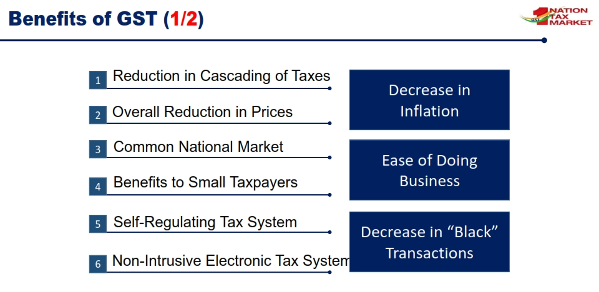

Slide 31
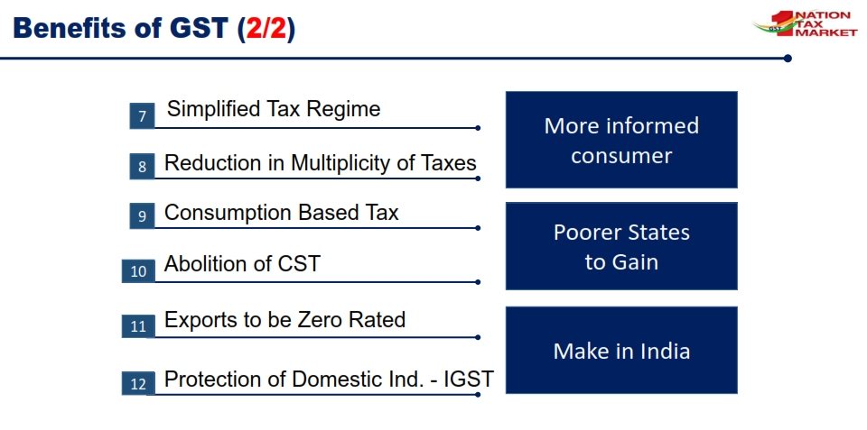

Slide 32
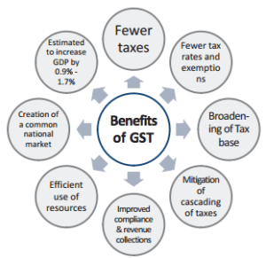

Slide 33
GST Rates
Rates: 0%( on essential items, rice/wheat)
5%: ( on items of mass consumption )
12%/18%:(standard rates covering most manufactured items and Services)
28% : ( on Consumer Durable Goods, Pan masala, tobacco and aerated drinks etc)
Basic philosophy behind these rates are that, to the extent possible, the current combined rate of tax levied on individual goods by the Central and the State Governments should be maintained in GST
Uniform GST rate not possible at this stage as luxury goods and goods consumed by poorer sections of society cannot be taxed at the same rate
Rates will be notified by Government on recommendations of GST Council.
Notes:
GST Rate schedule shall be notified later.

Slide 34
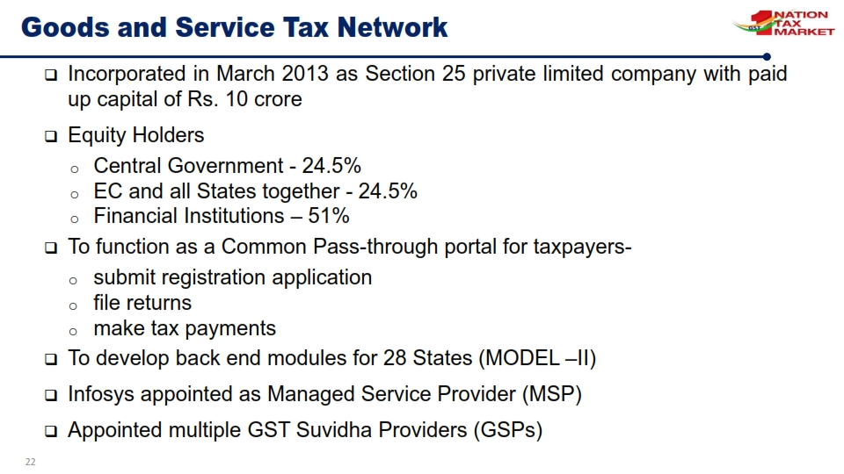
Notes:
GST Rate schedule shall be notified later.

