Slide 1

Dr. Varun Bansal
Professor, School of Engineering and Technology
Shobhit University Gangoh
Topic : - Automata
Shobhit University Gangoh

Slide 2
Automata – What is it?
As word suggests “TOC” is the study of “mathematical” machines , Model or “systems” called automata.
Me students , EC students study machines.
The term "Automata" is derived from the Greek word "αὐτόματα" OR “automaton”which means "self-acting".
This automaton consists of states and transitions. The State is represented by circles, and the Transitions is represented by arrows.
An automaton with a finite number of states is called a Finite Automaton (FA) or Finite State Machine (FSM).

Slide 3
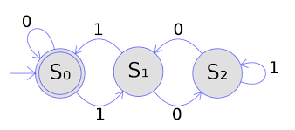
Machine

Slide 4
We need a language for communication (human to human Complex communication- jeans t-shirts taunt) with machine.
Two human communication is not easy to understand but because our neurons are training from by birth.
But we do not require natural language to communicate with the machine..
Languages can be of two types formal languages and informal languages, here in this subject we will only discuss only formal languages.

Slide 5

Methods to define languages English alphabet 26
In natural language we define the list of words in a dictionary because they are finite and predefined but we cannot list all the sentence which can be formed using theses words as they are infinite. Alphabets – words (finite) – sentences (infinite)- language
So, we have a mechanism called Grammer/ rules using which we can decide which sentences is valid and which is invalid.

Slide 6
Automata is the kind of machine which takes some string as input and this input goes through a finite number of states and may enter in the final state.
There are the basic terminologies that are important and frequently used in automata:

Slide 7
Symbols: “letters” in general we called alphabet
Symbols are an entity or individual objects, which can be any letter, alphabet or any picture.
Example:
1, a, b, #, *, cow, white flag (in)

Slide 8
Alphabets:
Alphabets are a finite set of symbols. It is denoted by ∑.
Is there any language where the alphabets is infinte.
Examples:
    ∑ = {a, b}
    ∑ = {A, B, C, D}
    ∑ = {0, 1, 2}
    ∑ = {0, 1, ....., 5]
    ∑ = {#, β, Δ}

Slide 9
String: is called- Word
It is a finite collection of symbols from the alphabet. The string is denoted by w.
Example 1:
If ∑ = {a, b}, various string that can be generated from ∑ are {ab, aa, aaa, bb, bbb, ba, aba.....}.
A string with zero occurrences of symbols is known as an empty string. It is represented by ε.
The number of symbols in a string w is called the length of a string. It is denoted by |w|.
Example 2:
w = 010
Number of Sting |w| = 3

Slide 10
Language
A language is a collection of appropriate string. A language which is formed over Σ can be Finite or Infinite.
Example: 1
L1 = {Set of string of length 2}
= {aa, bb, ba, bb} Finite Language

Slide 11
Example: 2
L2 = {Set of all strings starts with 'a’}
= {a, aa, aaa, abb, abbb, ababb} Infinite Language

Slide 12
Some basic operation on String
So. Before we proceed further lets do a work on string, which will help us throughout the subject.
Length of a string: It is defined as number symbol in the string denoted like |W|
Length of string |00110| = 5
|aaba| =
|010| =

Slide 13
Concatenation of string
Let X and Y be two strings then Concatenation is defined as the string formed by making a copy of string X followed by a copy of string Y.
E.g. W= ab , X= ba
WX = ?
XW = ?

Slide 14
Reverse of String
If there is a String W then reverse of a string a denoted by Wr is just the same string but written in reverse order.
W= W1W2W3W4………… Wn
Wr = ?
|W| are equal or not |Wr|

Slide 15
Empty / Null String
The String with zero occurrence of symbols. It is denoted by ϵ (epsilon)
| ϵ | = 0
If there is a string W , then Wr stands for the string obtained by repeating W n times.
W3 = WWW
W2= WW
W1=W
W0= ϵ
w ϵ = ϵ W =
ϵ = λ = ^

Slide 16
Substring : any string of consecutive symbols in some string “W” can be Collectively said a substring. W= abab its substring can be ab, a, ba etc.
Substring
1. utg
2. sbr
3. rts
4. str
5. sub
6. ϵ

Slide 17
Ques. Consider a string “GATE” find the total number of substring possible?
 | Substring of length 0 | Substring of length 1 | Substring of length 2 | Substring of length 3 | Substring of length 4
Number of String Possible | 1 | 4 | 3 | 2 | 1
SUBSTRING | ϵ | G,A,T,E | GA, AT, TE | GAT, ATE | GATE
n(n+1) / 2 +1

Slide 18
Ques. Consider a string “GGGE” find the total number of substring possible?
 | Substring of length 0 | Substring of length 1 | Substring of length 2 | Substring of length 3 | Substring of length 4
Number of String Possible | 1 | 2 | 2 | 2 | 1
SUBSTRING | ϵ | G, E | GG,GE | GGG, GGE | GGGE

Slide 19
Ques. Consider a string “GATE” find the total number of Prefix and suffix possible?
Prefix (GATE) = (ϵ , G, GA, GAT, GATE)
|W| = n => n+1
Suffix(GATE) = (ϵ ,E, TE, ATE, GATE)
|W| = n => n+1

Slide 20
Finite Automata
Finite automata are used to recognize patterns.
It takes the string of symbol as input and changes its state accordingly. When the desired symbol is found, then the transition occurs.
At the time of transition, the automata can either move to the next state or stay in the same state.
Finite automata have two states, Accept state or Reject state. When the input string is processed successfully, and the automata reached its final state, then it will accept.

Slide 21
Formal Definition of FA
A finite automaton is a collection of 5-tuple
(Q, ∑, δ, q0, F), where:
Q: finite set of states
∑: finite set of the input symbol
q0: initial state
F: final state
δ: Transition function
Transition function can be defined as:
δ: Q x ∑→Q

Slide 22
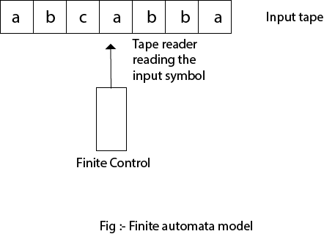

Slide 23
Finite Automata Model:
Finite automata can be represented by input tape and finite control.
Input tape: It is a linear tape having some number of cells. Each input symbol is placed in each cell.
Finite control: The finite control decides the next state on receiving particular input from input tape. The tape reader reads the cells one by one from left to right, and at a time only one input symbol is read.

Slide 24
Types of Automata:
There are two types of finite automata:
DFA(deterministic finite automata)
NFA(non-deterministic finite automata)

Slide 25
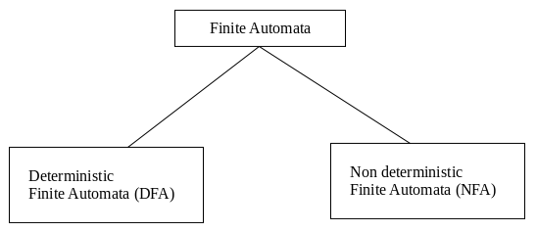

Slide 26
1. DFA
DFA refers to deterministic finite automata. Deterministic refers to the uniqueness of the computation. In the DFA, the machine goes to one state only for a particular input character. DFA does not accept the null move.
2. NFA
NFA stands for non-deterministic finite automata. It is used to transmit any number of states for a particular input. It can accept the null move.

Slide 27
Some important points about DFA and NFA:
Every DFA is NFA, but NFA is not DFA.
There can be multiple final states in both NFA and DFA.
DFA is used in Lexical Analysis in Compiler.
NFA is more of a theoretical concept.

Slide 28
Transition Diagram
A transition diagram or state transition diagram is a directed graph which can be constructed as follows:
There is a node for each state in Q, which is represented by the circle.
There is a directed edge from node q to node p labeled a if δ(q, a) = p.
In the start state, there is an arrow with no source.
Accepting states or final states are indicating by a double circle.

Slide 29
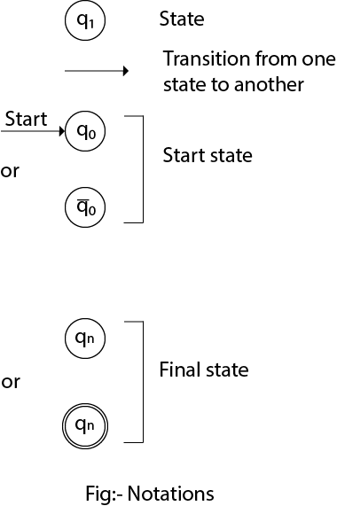
Some Notations that are used in the transition diagram:

Slide 30
Transition Table
The transition table is basically a tabular representation of the transition function. It takes two arguments (a state and a symbol) and returns a state (the "next state").
A transition table is represented by the following things:
Columns correspond to input symbols.
Rows correspond to states.
Entries correspond to the next state.
The start state is denoted by an arrow with no source.
The accept state is denoted by a star.

Slide 31
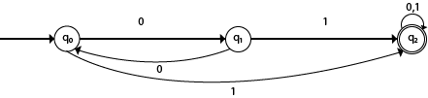
Example 1:

Slide 32
Solution:
Transition table of given DFA is as follows:
Present State | Next state for Input 0 | Next State of Input 1
→q0 | q1 | q2
q1 | q0 | q2
*q2 | q2 | q2

Slide 33
Explanation:
In the above table, the first column indicates all the current states. Under column 0 and 1, the next states are shown.
The first row of the transition table can be read as, when the current state is q0, on input 0 the next state will be q1 and on input 1 the next state will be q2.
In the second row, when the current state is q1, on input 0, the next state will be q0, and on 1 input the next state will be q2.
In the third row, when the current state is q2 on input 0, the next state will be q2, and on 1 input the next state will be q2.
The arrow marked to q0 indicates that it is a start state and circle marked to q2 indicates that it is a final state.

Slide 34

Example 2:

Slide 35
Solution:
Transition table of given NFA is as follows:
Present State | Next state for Input 0 | Next State of Input 1
→q0 | q0 | q1
q1 | q1, q2 | q2
q2 | q1 | q3
*q3 | q2 | q2

Slide 36
Explanation:
The first row of the transition table can be read as, when the current state is q0, on input 0 the next state will be q0 and on input 1 the next state will be q1.
In the second row, when the current state is q1, on input 0 the next state will be either q1 or q2, and on 1 input the next state will be q2.
In the third row, when the current state is q2 on input 0, the next state will be q1, and on 1 input the next state will be q3.
In the fourth row, when the current state is q3 on input 0, the next state will be q2, and on 1 input the next state will be q2.

Slide 37
DFA (Deterministic finite automata)
DFA refers to deterministic finite automata. Deterministic refers to the uniqueness of the computation. The finite automata are called deterministic finite automata if the machine is read an input string one symbol at a time.
In DFA, there is only one path for specific input from the current state to the next state.
DFA does not accept the null move, i.e., the DFA cannot change state without any input character.
DFA can contain multiple final states. It is used in Lexical Analysis in Compiler.

Slide 38
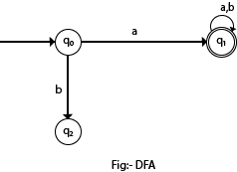
In the following diagram, we can see that from state q0 for input a, there is only one path which is going to q1. Similarly, from q0, there is only one path for input b going to q2.

Slide 39
Formal Definition of DFA
A DFA is a collection of 5-tuples same as we described in the definition of FA.
Q: finite set of states
∑: finite set of the input symbol
q0: initial state
F: final state
δ: Transition function
Transition function can be defined as:
δ: Q x ∑→Q

Slide 40
Graphical Representation of DFA
A DFA can be represented by digraphs called state diagram. In which:
The state is represented by vertices.
The arc labeled with an input character show the transitions.
The initial state is marked with an arrow.
The final state is denoted by a double circle.

Slide 41

Example 1:
Q = {q0, q1, q2}
∑ = {0, 1}
q0 = {q0}
F = {q2}
Solution:
Transition Diagram:

Slide 42
Transition Table:
Present State | Next state for Input 0 | Next State of Input 1
→q0 | q0 | q1
q1 | q2 | q1
*q2 | q2 | q2

Slide 43
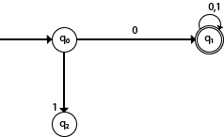
Example 2:
DFA with ∑ = {0, 1} accepts all starting with 0.
Solution:

Slide 44
Explanation:
In the above diagram, we can see that on given 0 as input to DFA in state q0 the DFA changes state to q1 and always go to final state q1 on starting input 0. It can accept 00, 01, 000, 001....etc. It can't accept any string which starts with 1, because it will never go to final state on a string starting with 1.

Slide 45

Example 3:
DFA with ∑ = {0, 1} accepts all ending with 0.
Solution:

Slide 46
Explanation:
In the above diagram, we can see that on given 0 as input to DFA in state q0, the DFA changes state to q1. It can accept any string which ends with 0 like 00, 10, 110, 100....etc. It can't accept any string which ends with 1, because it will never go to the final state q1 on 1 input, so the string ending with 1, will not be accepted or will be rejected.

Slide 47

Examples of DFA
Design a FA with ∑ = {0, 1} accepts those string which starts with 1 and ends with 0.
The FA will have a start state q0 from which only the edge with input 1 will go to the next state.
In state q1, if we read 1, we will be in state q1, but if we read 0 at state q1, we will reach to state q2 which is the final state. In state q2, if we read either 0 or 1, we will go to q2 state or q1 state respectively. Note that if the input ends with 0, it will be in the final state.

Slide 48

Example 2:
Design a FA with ∑ = {0, 1} accepts the only input 101.
In the given solution, we can see that only input 101 will be accepted. Hence, for input 101, there is no other path shown for other input.

Slide 49
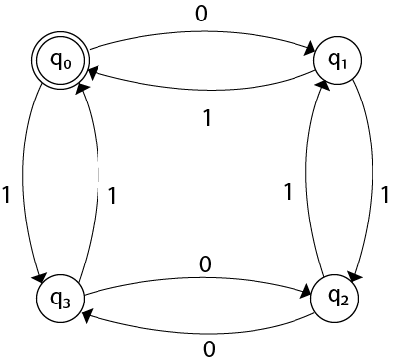
Example 3:
Design FA with ∑ = {0, 1} accepts even number of 0's and even number of 1’s.
This FA will consider four different stages for input 0 and input 1. The stages could be:
Here q0 is a start state and the final state also. Note carefully that a symmetry of 0's and 1's is maintained. We can associate meanings to each state as:
q0: state of even number of 0's and even number of 1’s.
q1: state of odd number of 0's and even number of 1's.
q2: state of odd number of 0's and odd number of 1's.
q3: state of even number of 0's and odd number of 1's.

Slide 50

Example 4:
Design FA with ∑ = {0, 1} accepts the set of all strings with three consecutive 0's.
Solution:
The strings that will be generated for this particular languages are 000, 0001, 1000, 10001, .... in which 0 always appears in a clump of 3. The transition graph is as follows:

Slide 52
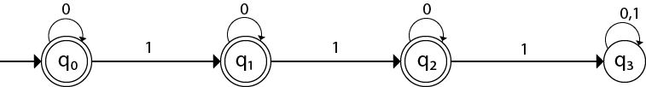
Example 5:
Design a DFA L(M) = {w | w ε {0, 1}*} and W is a string that does not contain consecutive 1’s.
When three consecutive 1's occur the DFA will be:
Here two consecutive 1's or single 1 is acceptable, hence
The stages q0, q1, q2 are the final states. The DFA will generate the strings that do not contain consecutive 1's like 10, 110, 101,..... etc.

Slide 53
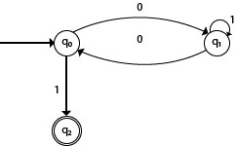
Example 6:
Design a FA with ∑ = {0, 1} accepts the strings with an even number of 0's followed by single 1.
The DFA can be shown by a transition diagram as:

Slide 54
Thank You

