Slide 1
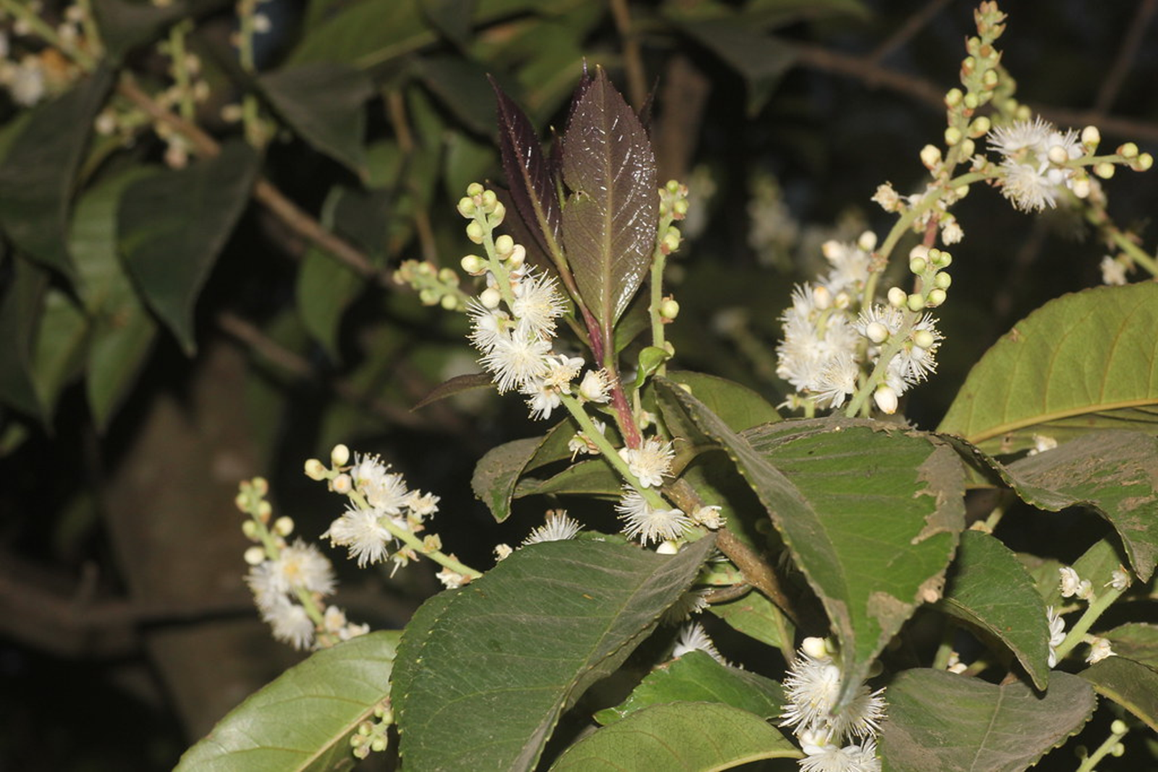
लोध्र
Botanical Name: Symplocos racemosa
FAMILY: SYMPLOCACEAE
Dr.AKHIL –T
ASSOCIATE PROFESSOR
DEPT.DRAVYAGUNA VIJNANA
K.S.V.A.M.C & RC,GANGOH

Slide 2
SYNONYMS
रोघ्र/ लोध्र = रुणन्छि व्रर्ण इति रोघ्रः । रलयोरैक्यात् लोध्रोऽपि। Lodhra/Rodhra has Vranashdhana and Ropana action.
Shaatvaraka :-found abundantly in hilly regions.
Tilaka :Having beautiful flowers
Bhillataru: Known to tribal people as Bhilli
Tirita: Inflorescence is golden in colour
Ghanatvak, Bruhattvak and Sthulatvak : Thick Bark
गालवः Produces watering of eyesगालयतिखावयति अक्षि ।

Slide 3
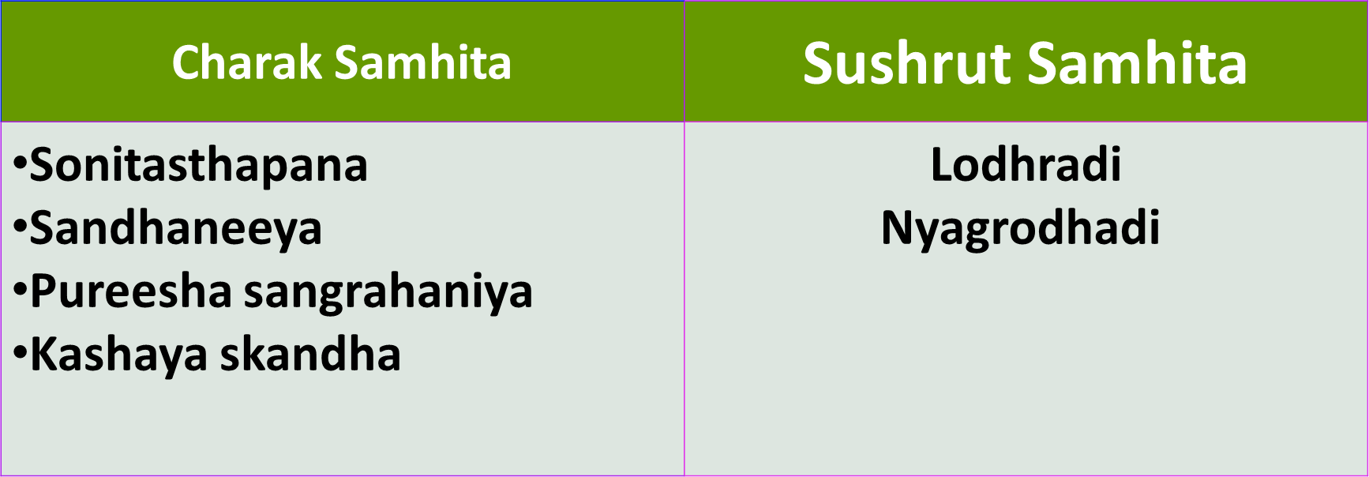

Slide 4
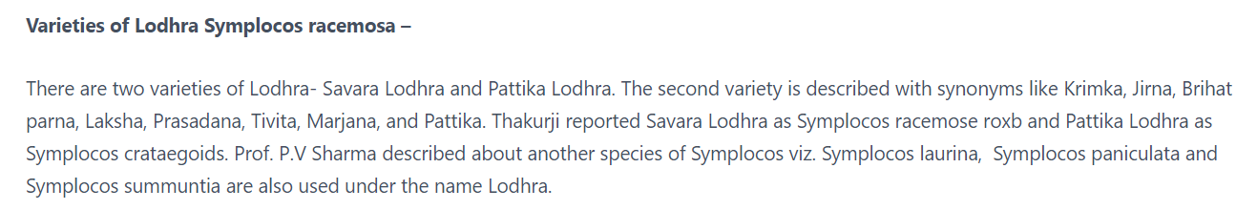
Bhavaprakasha Nighantu:- 1. LODHRA
2. PATTIKA LODHRA
Dhanwanthari Nighantu:- 1. LODHRA
2. KRAMUKA

Slide 5
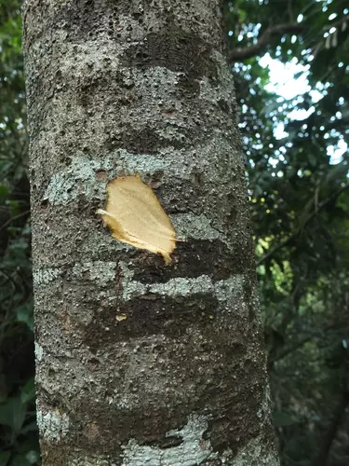
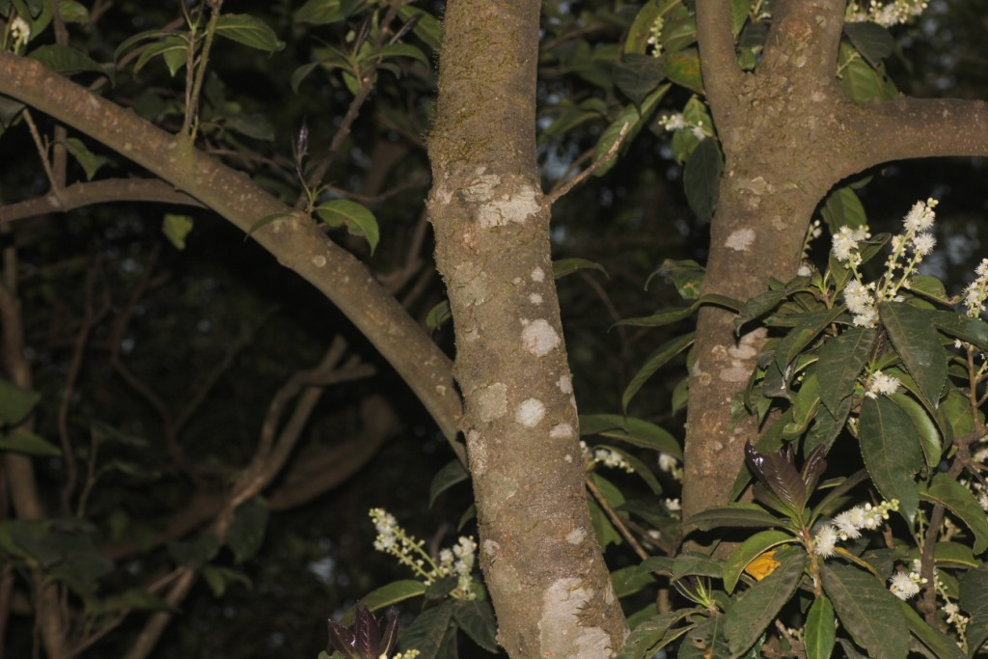
BOTANICAL DESCRIPTION
Lodhra is an evergreen medium size tree with height of 20 ft.
Bark greyish, lenticellate; blaze cream

Slide 6
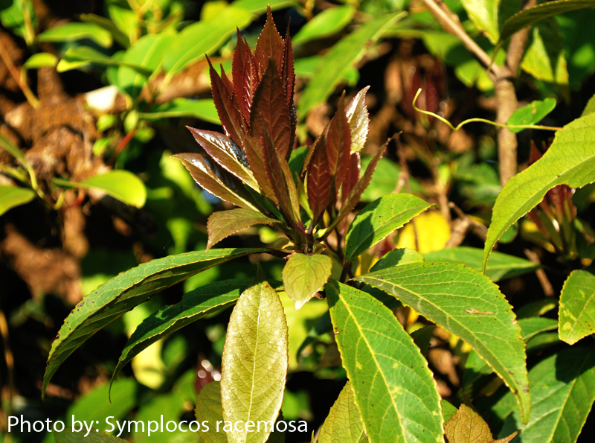
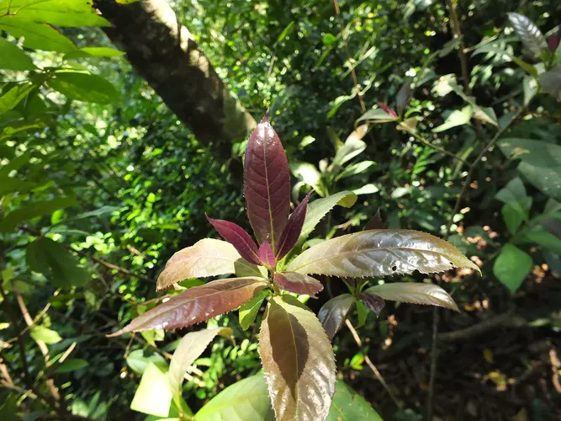
Leaves simple, alternate, 7-15 x 3-6 cm, elliptic or elliptic-obovate, tip pointed to tapering, margin rounded toothed-sawtoothed, hairless, shiny, leathery; leaf-stalk 6-15 mm long, slender; lateral nerves 6-12 pairs.

Slide 7
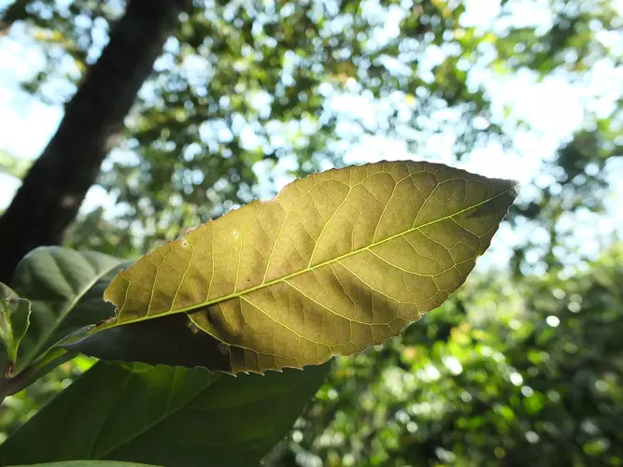

Slide 8
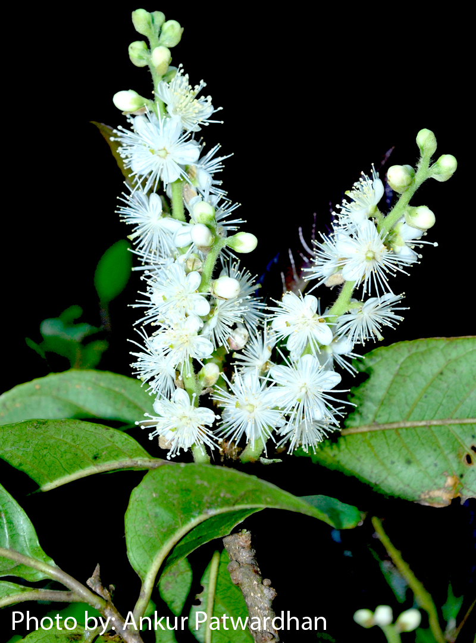
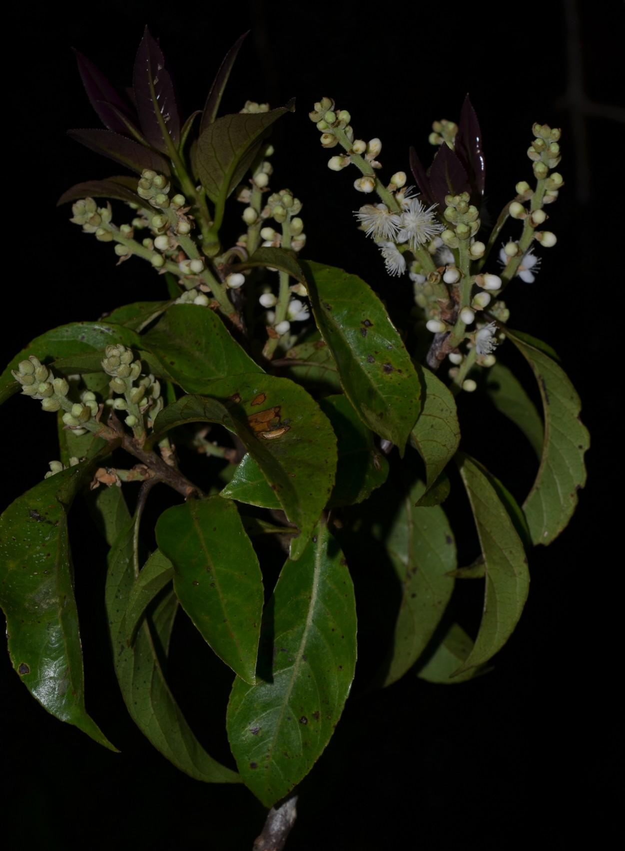
Flowers bisexual,
Inflorescence axillary racemes, up to 14 cm long, tomentose.
White fading yellow

Slide 9
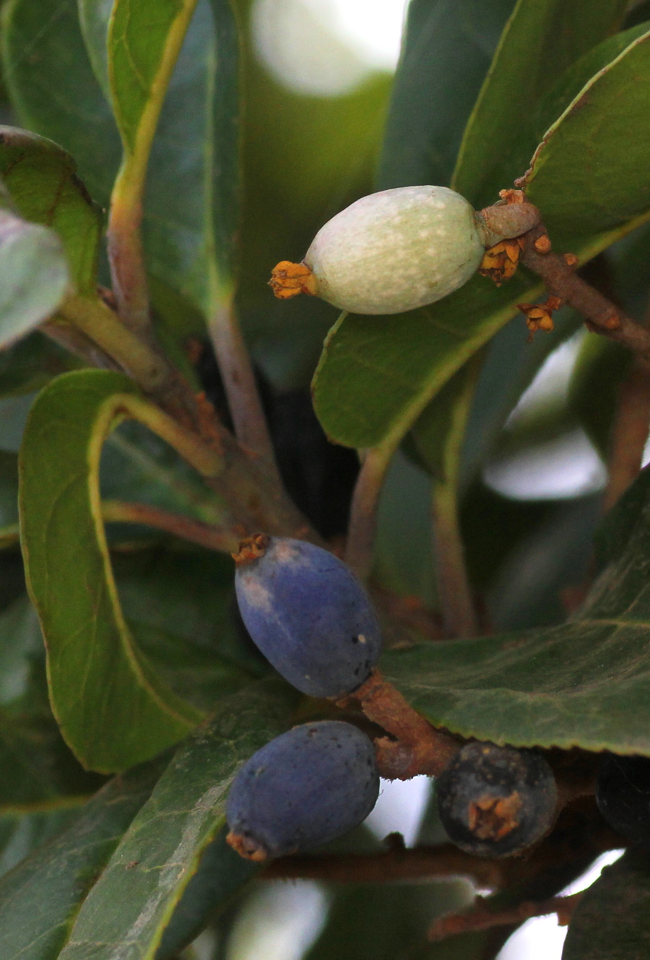
Fruit a drupe 15 x 5 mm, ovoid, shallowly furrowed, seeds 1-2, oblong

Slide 10
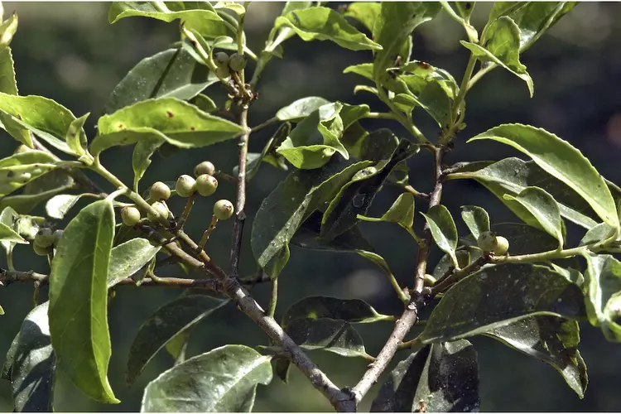
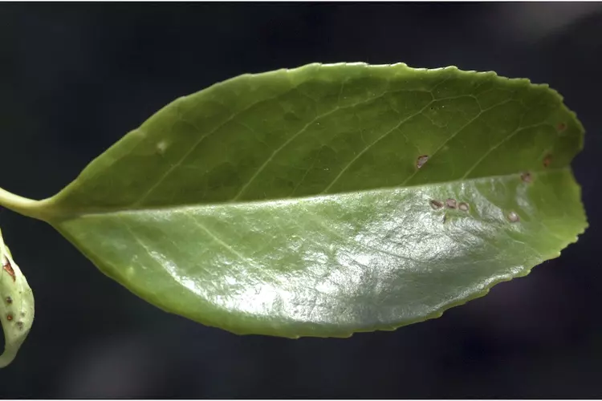
Symplocos cochinchinensis

Slide 11
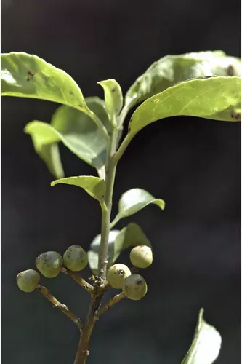
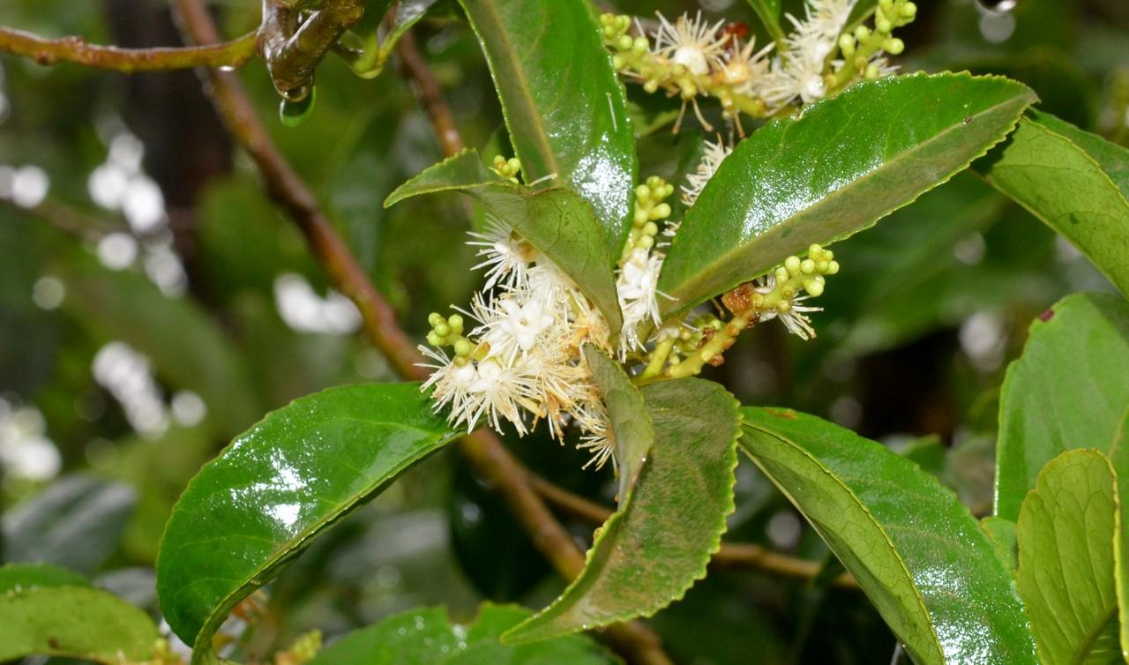

Slide 12
Useful Parts: Tvak (Stem bark)
Important Phytoconstituents: Alkaloids (loturine and colloturine) and red colouring matter. (A.P.I Volume I)

Slide 13
Rasa Panchaka:
Rasa:Kashaya
Guna:Laghu, Ruksha
Virya:Sheeta
Vipaka:Katu
Karma: Chakshushya, Grahi, Sothahara, Jwarahara, Visaghna
Doshaghnata:Kapha pitta shamaka
Action on mala: Graahi.
Dhatu: Raktastambhaka
Rogaghnata: Pradara, Pravahika, Shotha, Atisara, Raktapitta

Slide 14
PHARMACOLOGICAL ACTIONS
Antioxidant
Anti-acne
Anti-ulcer
Hypolipidemic
Hepatoprotective
Anticancer
Anthelmintic
Antiinflammatory
Antidiabetic
Antibacterial

Slide 15
AMAYIKA PRAYOGAS
Raktasrava: external application of lodhrachurna stops bleeding (Su.Su 14/36)
Mukhadushika: Paste of lodhra and spatika is applied (A.S.Su 37/5)
Pravahika: Lodhra with takra (B.P.Chi 2/120)
Pradara: Lodhrakalka should be taken with kwath of Nyagrodhatvak (Ch.chỉ 30/ 118)
Kushta: Bark lepa is applied
Tarunya pidaka: lepa made with lodhra and sphatika is applied over acne.

Slide 16
FORMULATIONS
Rodhrasava (Lodhrasava)- Garbhasaya Vikara
Pushyanug churna- Atisara,Yonidosa
Bruhat gangadhar churna- Atisara,Pravahika
Lodhradi Kwath- Pittaja Jwara
Lodhrotpaladi Kwath- Pittaja Jwara

