Slide 1
B. Pharm. 3rd Year
Subject: Medicinal Chemistry II (BP501T)
Unit: II
Chapter: Antihypertive Drugs
Topic
Introduction & classification
By
Dr. Zulphikar Ali
Associate Professor
Shobhit University, Gangoh

Slide 2

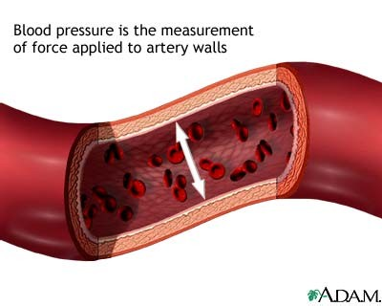
HYPERTENSION
It is defined as a physiologic condition where there is an increase in the arterial blood pressure above normal.
Normal B.P is 120/80 mm Hg.
An individual is hypertensive when
B.P is >140/90 mm Hg.

Slide 3
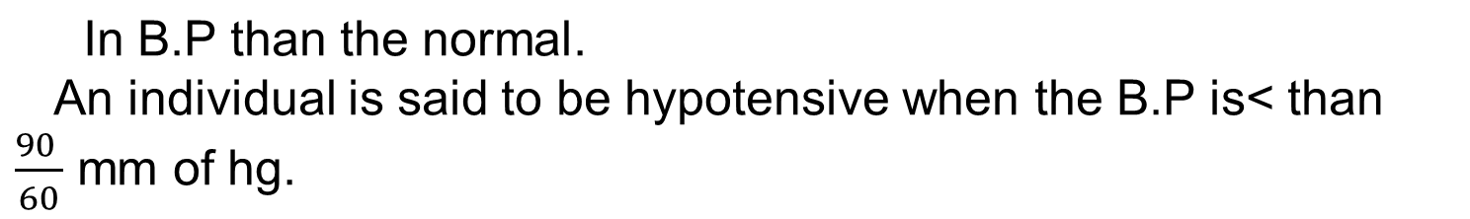
Hypotension may be defined as a physiologic state where there is a
HYPERTENSION IS DEVIDED IN TO 2 TYPES:
1.PRIMARY HYPERTENSION OR ESSENTIAL HYPERTENSION
1.SECONDARY HYPERTENSION OR MALIGNANT HYPERTENSION.

Slide 4
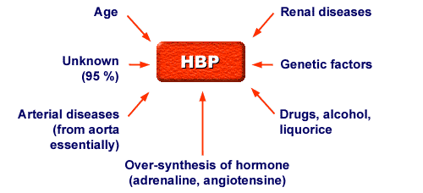
CAUSES OF HYPERTENSION

Slide 5
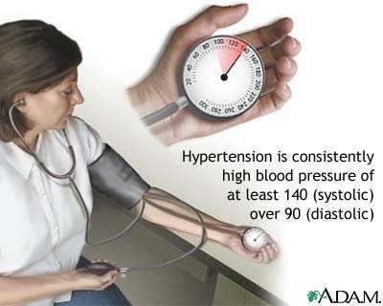
Diastolic
Classification
Systolic Blood Pressure (mmHg)
Blood
(category of
Pressure (mmHg)
Hypertension)
Normal (B.P)
120
and
80
Prehypertension
121-139
or
81-89
Stage 1 (mild) hypertension
Stage 2 hypertension (moderate)
140-159
or
90-99
160-179
or
100-109
Stage III (severe)
180-209
110-119.
Stage iV (very
severe)
>210
>120.
Chobanian AV, Bakris GL, Black HR, et al. Seventh report of the Joint National Committee on Prevention, Detection, Evaluation, and Treatment of High Blood Pressure. Hypertension 2003;42(6):1206–1252.
6

Slide 6




Classification of antihypertensive agents
Hypertension = Disease of the blood vessels
Vascular biology altered Treat the vasculature Therapeutic options
Beta Blockers
ARB CCB
ACE
Diuretics
Others
Adapted from Vascular Biology Working Group, University of Florida College of Medicine, Carl Pepine, MD, Director
10

Slide 7




Depending on chemical classification
ACE inhibitors
Sulphydryl E.g:Captopril
Dicarboxylate E.g:Enalapril
,Lisinopril
Phosphate E.g:Fosinopril

Slide 8


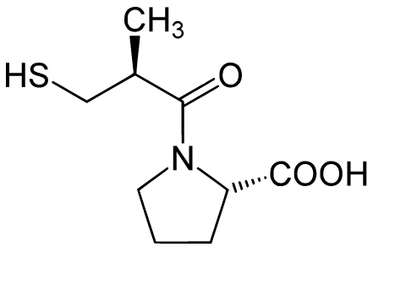
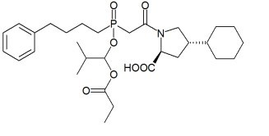
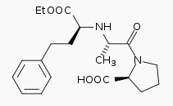

FOSINOPRIL
CAPTOPRIL
ENALAPRIL

Slide 9
References
Ashutosh Kar, 2006, Medicinal Chemistry, 4th Edition, New Delhi, New Age International (P) Limited Publishers.
Wilson and Gisvold, 2011, Textbook of Organic Medicinal and Pharmaceutical Chemistry, 12th Edition, London, Lippincott Williams & Wilkins.
A. Pragi, A Varun & K. Davinder, 2019, A textbook of Medicinal Chemistry-I, Punjab, India, S. Vikas and Company (Medical Publishers).

Slide 10
Thank You

