Slide 1
Lecture - 10
Department of Kayachikitsa

Slide 2
Dyslipidemia
Dr. Shagufta Malhotra
Assostant professor
Department of Kayachikitsa
Shobhit University

Slide 3
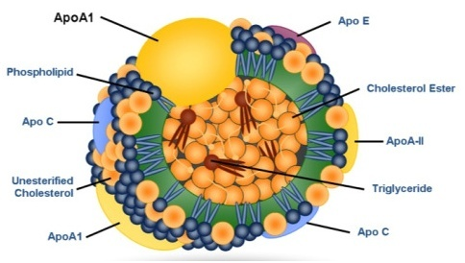
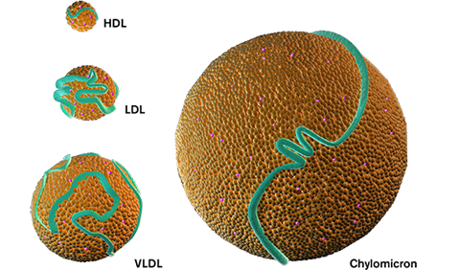
What is Dyslipidemia?
Dyslipidemia is a disorder of lipoprotein metabolism, which can include overproduction or deficiency or both of the lipoproteins.
They may manifest as one or more of the following: Elevated total cholesterol, low-density lipoprotein cholesterol (LDL), & triglyceride levels or as decreased high-density lipoprotein cholesterol (HDL) level.
It contributes to the development of atherosclerosis.

Slide 4
Lipid transport
Lipids are carried in plasma in lipoproteins after getting associated with several apoproteins;
plasma lipid concentrations are dependent on the concentration of lipoproteins.
The core of lipoprotein globules consists of triglycerides (TGs) or cholesteryl esters (CHEs) while the outer polar layer has phospholipids, free cholesterol (CH) and apoproteins.
The lipoproteins have been divided into 6 classes on the basis of their particle size and density. They also differ in the nature of apoproteins, the ratio of TG and CHE, tissue of origin and fate.

Slide 5
Dietary lipids are absorbed in the intestine with the help of bile acids.
Chylomicrons (Chy) are formed and passed into lacteals—reach blood stream via thoracic duct.
During their passage through capillaries, the endothelium bound lipoprotein lipase hydrolyses the TGs into fatty acids which pass into muscle cells to be utilized as energy source and in fat cells to be reconverted into TGs and stored.

Slide 6
The remaining part—chylomicron remnant (Chy. rem.) containing mainly CHE and little TG is engulfed by liver cells, which have receptors for the surface apoproteins of Chy. rem., and digested.
Free CH that is liberated is either stored in liver cells after reesterification or incorporated into a different lipoprotein and released in blood or excreted in bile as CH/ bile acids.
Liver secretes very low density lipoproteins (VLDL) containing mainly TG and some CHE into blood.

Slide 7
VLDL is acted upon by endothelial lipoprotein lipase in the same way as on Chy and the fatty acids pass into adipose tissue and muscle; the remnant called intermediate density lipoprotein (IDL) now contains more CHE than TG.
About half of the IDL is taken back by the liver cells by attachment to another receptor (LDL receptor), while the rest loses the remaining TGs gradually and becomes low density lipoprotein (LDL) containing only CHE.
The LDL circulates in plasma for a long time; its uptake into liver and other tissues is dependent on the need for CH. The rate of LDL uptake is regulated by the rate of LDL receptor synthesis in a particular tissue.

Slide 8
The CHE of LDL is deesterified and used mainly for cell membrane formation.
The CH released into blood from degradation of membranes is rapidly incorporated in high density lipoproteins (HDL), esterified with the help of an enzyme lecithin: cholesterol acyltransferase (LCAT) and transferred back to VLDL or IDL, completing the cycle.
The excess lipoproteins in plasma are phagocytosed by macrophages for disposal.
When too much of lipoproteins have to be degraded in this manner, CH is deposited in atheromas (in arterial walls) and xanthomas (in skin and tendons). Raised levels of VLDL, IDL and LDL (rarely Chy and Chy. rem. also) are atherogenic, while HDL may be protective, because HDL facilitates removal of CH from tissues.

Slide 9

EPIDEMIOLOGY
Epidemiological studies have established that Dyslipidemia has been closely linked to the pathophysiology of CVD.
Cardiovascular disease is the leading cause of death worldwide and mortality due to CVD is higher in low and middle income countries.
In India, there has been an alarming increase in the prevalence of CVD over the past two decades so much so that accounts for 24% of all deaths among adults aged 25–69 years.
It is estimated that by 2020, CVD will be the largest cause of disability and death in India with 2.6 million Indians predicted to die due to CVD.

Slide 10

Contd…
The World Health Organization estimates that dyslipidemia is associated with more than half of global cases of ischemic heart disease and more than 4 million deaths per year.
World Health Organization (WHO) in 2002 reported that high cholesterol level is one of the main non-communicable disease-related risk factors in India.
For every 1% reduction in lipid level, the risk of heart diseases reduce by 2.5%.

Slide 11
Fredrickson Classification:
(based on Lipoprotein Patterns /Phenotypic)
Phenotype | Elevated Lipoprotein | Elevated Lipids
I | Chylomicrons | TGs
IIa | LDL | Cholesterol
IIb | LDL and VLDL | TGs and cholesterol
III | VLDL and Chylomicron remnants | TGs and cholesterol
IV | VLDL | TGs
V | Chylomicrons and VLDL | TGs and cholesterol

Slide 12
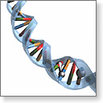

Classification based on Aetiology:
Primary Dyslipidemia
1) Single or multiple genetic mutation results in either overproduction or defective clearance of TG & LDL-C or in underproduction or excessive clearance of HDL
2)Suspected in pt’s with physical signs.
3) Most common cause of Dyslipidaemia in children
Most common forms are
-FH
-F def. Apo B-100
-Polygenic hyperchole.
-LPL deficiency
-Apo C-II def.
-FHTG
-FCH
-FDBL
Secondary Dyslipidemia
1)Contribute to most cases of Adults
2) Most imp. Cause is sedentary lifestyle with excessive dietary intake of saturated fat, cholesterol & trans fats.
3)Other common sec. Causes are- DM, alcohol overuse, CKD, hypothyroidism,
Pri. Billiary cirrhosis, cholestatic liver disease &
Drugs like- thiazides, βblockers, retinoids, estrogen, progetsin, glucocorticoids.

Slide 13
Disorder | Genetic defect /Mechanism | inheritance | prevalence | Clinical features
Familial hypercholestrolaemia | LDL receptor defect , diminished LDL clearance | Autosomal dominant | Heterozygotes: 1/500 Homozygotes : 1/1million | Tendon xanthomas, arcus senilis, prematureCAD (age 30-50) TC:250-500mg/dl planter & tendon xanthomas & premature CAD ( before age 18.)
Familial defective Apo B -100 | ApoB( LDL receptor binding region defect) Diminished LDL clearance | Dominant | 1/700 | Xanthomas Arcus senillis, premature CAD, TC:250-500mg/dl
Polygenic hypercholesterolemia | Unknown , possibly multiple defects & Mechanism | Variable | common | Premature CAD TC:250-350mg/dl
LPL deficiency | Endothelial LPL defect Diminished chylomicron clearance | Recessive | Rare but present worldwide | Failure to thrive (in infants), Xanthomas , hepatosplenomegaly, Pancreatitis, TG: >750mg/dl

Slide 14
Apo C-II deficiency | Apo-C II ( causing functional LPL deficiency ) | Recessive | <1/1 million | Pancreatitis ( in some adults) Metabolic Syndrome ( often present ) TG : >750mg/dl
Familial hypertriglyceridemia | Unknown , possibly multiple defects & mechanism | Dominant | 1/100 | Usaully no symptoms or findings, ocassionaly, hyperuricemia, sometimes early atherosclerosis TG : 200-500mg/dl, Possibly higher depending on diet & alcohol use
Familial combined hyper lipidaemia | Unknown , possibly multiple defects & mechanism | Dominant | 1/50 to 1/100 | Premature CAD responsible for 15% of MIs in people < 60yr of age ApoB : Disproportionately elevated TG : 250-750mg/dl TC : 250-500mg/dl
Familial Dysbeta lipoproteinaemia | Apo E( usually homozygotes) Diminished chylomicron & VLDL clearance | Recessive ( more common) Dominant ( less common) | 1/5000 Present worldwide | Xanthomas ( especially palmer ), Yellow palmer creases, premature CAD, TG : 250-500mg/dl TC : 250-500mg/dl

Slide 15
Secondary Dyslipidemia
(Diabetic, obesity etc)
Consequence of obesity and/or poor control of diabetes, increases circulating FFAs, leading to increased hepatic VLDL production.
Diabetic women may be at special risk for cardiac disease.
promoting formation of TG-rich, small, dense LDL and clearance of TG-rich HDL.
Often exacerbated by the increased caloric intake and physical inactivity that characterize the lifestyles of some patients with DM-2.

Slide 16
Secondary Causes of Lipoprotein Abnormalities
Hypercholesterolemia
Hypothyroidism; Obstructive liver disease; Nephrotic syndrome; Drugs: progestogens, cyclosporine, thiazides
Hypertriglyceridemia
Obesity, DM, Pregnancy, CRF, Alcohol, Stress, Sepsis, Acute hepatitis, SLE, Drugs: estrogen, β-blockers, steroids, acid resins, thiazides
Low HDL
Type-2 DM, Rheumatoid arthritis, Malnutrition, Obesity, Cigarette smoking, Beta blockers

Slide 17
Classification of Dyslipidemia
Dyslipidaemia have been traditionally classified by patterns of elevation in lipids and lipoproteins (Fredrickson phenotype).
Again Dyslipidaemia can be classified as primary or secondary and characterizes by:
Increases in cholesterol only (pure or isolated hypercholesterolemia)
Increases in TGs only (pure or isolated hypertriglyceridemia)
Increases in both cholesterol and TGs(mixed or combined Hyperlipidaemia)

Slide 18
Sign and Symptom
Usually asymptomatic but often
lead to atherosclerotic vascular disease.

Slide 19

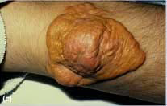
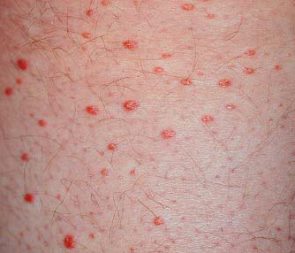
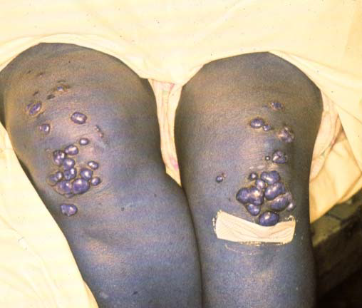
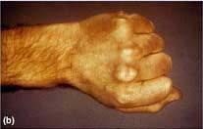
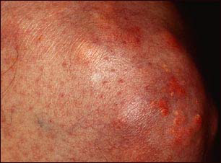
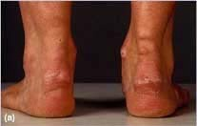
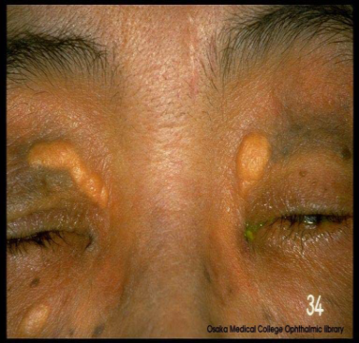
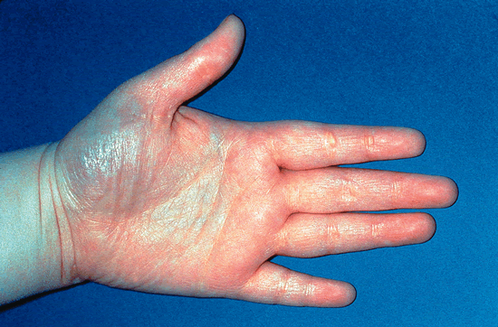
Planar xanthoma:
Various Cutaneous manifestations of Dyslipidaemia
Eruptive xanthoma:
Tuberous xanthoma:
Tendinous xanthoma:
Xanthelasma:
Palmar xanthoma:

Slide 20
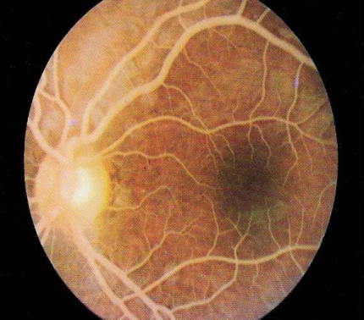
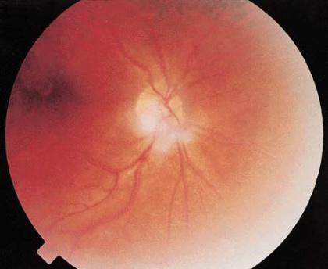
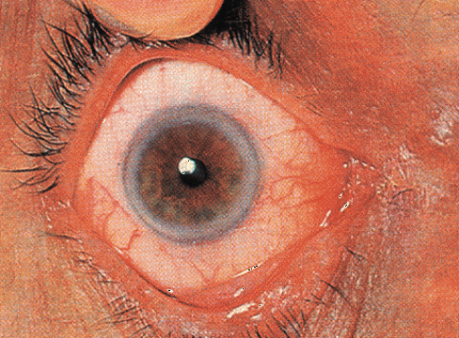
Ophthalmic manifestations of Dyslipidemia
Lipemia retinalis:
Lipemia retinalis:
Arcus corneae:

Slide 21
How to Calculate LDL Cholesterol?
HDL & TGs are measured directly in the lab.
LDL can be calculated using a specific equation.
If TG is > 400 mg/dl then this formula is not accurate & LDL must be measured directly in the lab.
LDL-C = Total Cholesterol – (HDL-C + TG/5)

Slide 22

Diagnosis & screening:
Serum Lipoproteins | Fasting values( mg/dl) | Interpretation
Total cholesterol | < 200 | Desirable
 | 200 -239 | Borderline High
 | > or = 240 | High
LDL cholesterol | < 100 | Optimal
 | 100-129 | Near optimal
 | 130-159 | Borderline high
 | 160-189 | High
 | > or = 190 | Very High
HDL cholesterol | < 40 | Low
 | >or = 60 | High
Triglycerides | < 150 | Desirable
 | 150-199 | Borderline high
 | 200-499 | High
 | >or =500 | Very high

Slide 23
Major Risk factors for CAD in pt’s of Dyslipidemia
Modifiable Risk Factors | Non Modifiable Risk Factors
Hypertension | Age
Cigarette smoking | Male
Thrombogenic/ hemostatic state | Family history of premature CHD
Diabetes
Obesity
Physical inactivity
Atherogenic Diet

Slide 24
How to Calculate LDL Cholesterol?
HDL & TGs are measured directly in the lab.
LDL can be calculated using a specific equation.
If TG is > 400 mg/dl then this formula is not accurate & LDL must be measured directly in the lab.
LDL-C = Total Cholesterol – (HDL-C + TG/5)

Slide 25
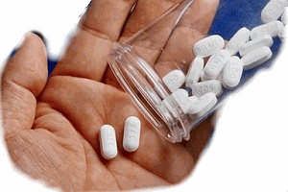
Two Approaches for lipid lowering therapy:
Lifestyle change / Non drug management of Dyslipidemia
Drug therapy i.e. Pharmacological management of Dyslipidemia

Slide 26

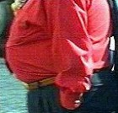




Non drug management:
Dietary modification
Weight reduction
Regular physical activity
Smoking cessation
Restriction to Alcohol intake
Stress management

Slide 27
Therapeutic Life Style Changes
Nutrient | Recommended intake
Total fat | 25-35% of total calories
Saturated fat | < 7% of total calories
Polyunsaturated fat | Up to 10% of total calories
Monounsaturated fat | Up to 20% of total calories
Carbohydrates | 50-60% of total calories
Fiber | 20-30 g/day
Cholesterol | < 200 mg/day
Protein | 15% of total calories

Slide 28
Pharmacological management
Class | Drugs available | Dosage | Major lipoprotein decreased | Mechanism | Major side effect
Bile acid sequestrations | colestyramine | 4-12g B.D | LDL | Increase sterol excretion LDL receptor mediated clearance of LDL | Gastrointestinal symptoms, binds other drugs
 | cholestipol | 5-15gm B.D.
Nicotinic Acid | Niacin | 1-2gm TDS | VLDL(LDL) | Decrease VLDL production | Flushing, Hyperglycemia, Hepatic Dysfunction, Gout
Fibritic Acid Derivatives | Gemfibrozil | 600mg B.D. | VLDL(LDL) | VlDL production LPL action | Gall stones, Myopathy
 | FenoFibrate | 67-201mg/d
HMG–CoA Reductase inhibitors | Lovastatin | 10-80mg/D | LDL | Cholesterol synthesis Receptor Mediated removal of LDL | Hepatic Dysfunction, Myopathy
 | Pravastatin | 10-40 mg/d
 | Simvastatin | 5-80 mg/d
 | Fluvastatin | 20-80 mg/d
 | Atorvastatin | 10-80mg

Slide 29
The Guideline for selection of Hypolipidaemic Drugs
Hyperlipidaemia | Monotherapy Drugs | Drug Combination
Elevated LDL & normal TG | Statins Bile acid sequestrants Nicotinic acids ERT in women. | Statins + Bile acids sequestrants Bile acid sequestrants + Niacin Statins + Niacine
Elevated LDL-C & TG | Statins Gemfibrozil Niacine
Elevated TG | Gemfibrozil Niacine

Slide 30
Thank You

