Slide 1
LEPROSY
By:
Dr. Namit Vashistha
Professor and HOD
DEPARTMENT OF SWASTHAVRITTA AND YOGA

Slide 2
INTRODUCTION
Leprosy is a disease caused by bacteria Mycobacterium
Leprae.
It causes damage to the skin and the peripheral nervous
system.
The disease develops slowly (from six months to 40
years!) and results in skin lesions and deformities, most
often affecting the cooler places on the body (for example,
eyes, nose, earlobes, hands, feet, and testicles).

Slide 3
Epidemiology
Despite the discovery of Mycobacterium leprae more than century ago and world wide research since then, several epidemiological features of leprosy are still poorly understood.
Among the classical epidemiological triad, the agent M. leprae is probably best described, but its entry and exit from the host, its passage into the Schwann cells of peripheral nerves, the incubation period from entry to manifestation of the disease, are at best guesstimates.

Slide 4
Children are probably most vulnerable to infection by M. leprae and after a long incubation period, leprosy manifests during adolescence or young adulthood. The sex ratio of leprosy in children is nearly equal and skews towards males in adults.
India was one among the 12 countries which failed in 2000 to reach the elimination target of less than one case of leprosy per 10,000 population set by the WHO but it achieved this goal in 2005, a major milestone not only for India but globally. The efforts are now directed towards elimination at subnational levels.

Slide 5
Signs of leprosy
Pale or slightly reddish patch
Definite loss of sensation in the patch
Signs of damage to nerves
definite loss of sensation in cooler areas of body hands/feet
weakness of muscles of hands/feet/face
visible deformity of hands/feet/face

Slide 6
Symptoms
Symptoms are similar to those that may occur with syphilis, tetanus.
Numbness and loss of temperature sensation (cannot
sense very hot or cold temperatures) are some of the first symptoms that patients experience.
As the disease progresses, the sensations of touch,
then pain, and eventually deep pressure are decreased
or lost.

Slide 7
Types of leprosy
The forms of leprosy are based on the person's immune response to M. Leprae.
Indeterminate leprosy: a few hypopigmented
macules; can heal spontaneously, persists or
advances to other forms.

Slide 8
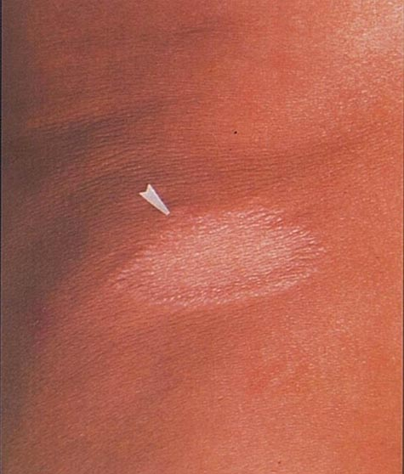
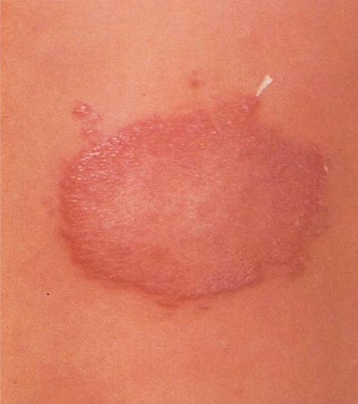
Indeterminate leprosy:

Slide 9
Tuberculoid leprosy
A few hypopigmented macules, some are large and some become anesthetic (lose pain sensation) some neural involvement in which nerves become enlarged;
spontaneous resolution in a few years, persists or advances to other forms.

Slide 10
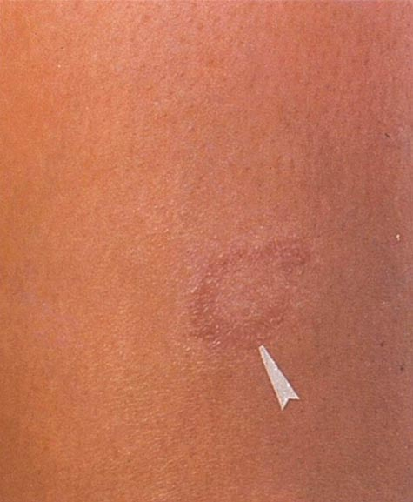
Tuberculoid leprosy

Slide 11
Borderline tuberculoid leprosy
lesions like tuberculoid leprosy but smaller and more numerous with less nerve enlargement; this form may persist, revert to tuberculoid leprosy, or advance to other forms.

Slide 12
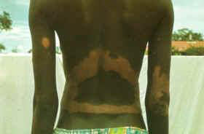
Borderline tuberculoid leprosy

Slide 13
Borderline lepromatous leprosy
Many skin lesions with macules (flat lesions) papules
(raised bumps), plaques, and nodules,sometimes with
or without anesthesia; theform may persist, regress or
progress to lepromatous leprosy.

Slide 14
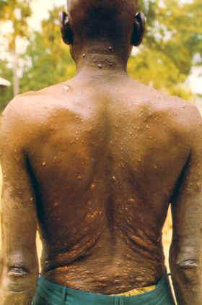
Borderline lepromatous leprosy

Slide 15
Mid-borderline leprosy
Many reddish plaques that are asymmetrically distributed,moderately anesthetic, with regional adenopathy (swollen lymph nodes); the form may persist, regress to another form, or progress.

Slide 16
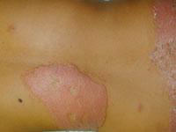
Mid-borderline leprosy

Slide 17
Lepromatous leprosy
Early lesions are pale macules (flat areas) that are diffuse and symmetric; later many M. leprae organisms can be found in them. Alopecia (hair loss) occurs; often patients have no eyebrows or eyelashes. As the disease progresses, nerve involvement leads to anesthetic areas and limb weakness; progression leads to aseptic necrosis (tissue death from lack of blood to area), lepromas (skin nodules), and disfigurement of many areas.

Slide 18
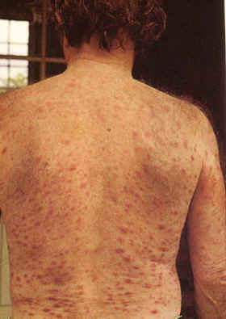
Lepromatous leprosy

Slide 19
Pathology
The earliest clinically detectable lesions of leprosy involve the skin and show histologic association with sebaceous glands and hair follicles. From the onset,small cutaneous nerve fibers are involved. With bacillary multiplication, contiguous skin areas,including autonomic nerve fibers,dermal appendages, and blood vessels, are invaded.

Slide 20
As infection spreads along sensory nerves,motor fibers within
parent nerve trunks are damaged. Leprosy bacilli are unable to penetrate directly into the nervous system proximal to the dorsal root ganglions; central nervous system infection does not occur.
When there is dense proliferation of leprosy bacilli, as in
lepromatous leprosy, bacteremia is virtually continuous, and
bacilli are easily demonstrable in many organs. Yet, there is
little systemic reaction, and tissue destruction occurs mainly in
cool, superficial locations: the skin (except in folds);
peripheral nerves in subcutaneous loci, oral and
nasopharyngeal mucous membranes (not enteric or vaginal);
the testes (not the ovaries); and the anterior third of the eye.

Slide 21
Transmission
Nasal droplet
Infected soil
Aerosolized M.Leprae
Sneeze
Direct dermal inoculation
Leprosy can also be hereditary
Routes of transmission are still being researched for leprosy

Slide 22
Who is at risk?
It can affect all ages and both sexes
95% of people who are exposed do not develop
Mainly affects:
– Skin
– Eyes
– The peripheral nerves
– Mucosa of the upper respiratory tract

Slide 23
How to examine for leprosy?
Examine in a well-lit room
Examine the whole body
Ask since when the patch was noticed
Ask what treatments have been tried
Test for sensation
Look for any visible deformities

Slide 24
Check for loss of sensation
Take a pointed soft object (feather, cotton wick)
Lightly touch alternately the patch & normal skin
Ask the person to point where they were touched
Ask them to close their eyes and repeat the procedure
In case of loss of sensation the person will be able to
point to where they were touched on the normal skin
but not on the patch.

Slide 25
PREVENTION
Prevention of contact with droplets from nasal and other secretions from patients.
Treatment of patients with appropriate antibiotics stops the
person from spreading the disease.
People who live with individuals who have untreated
leprosy are about eight times as likely to develop the disease,
because investigators speculate that family members have close
proximity to infectious droplets.
Leprosy is not hereditary, but recent findings suggest susceptibility to the disease may have a genetic basis.

Slide 26
Goals of Treatment
Major goals of treatments are:
Early detection of patients
Appropriate treatment
Adequate care for the prevention of disabilities and rehabilitation

Slide 27
Pharmacological Treatment
Multiple Drug Treatment (MDT)
There are several effective chemotherapeutic agents:
Dapsone (diaphenylsulfone, DDS)
Rifampicin (RFP)
Clofazimine (CLF),
Ofloxacin (OFLX)
Minocycline (MINO) constitute the backbone of the
multidrug therapy (MDT) regimen.

Slide 28
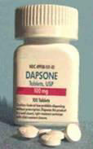
About Dapsone
Available in 25mg & 100 mg tablets
Rated a pregnancy risk category C by the American Food and Drug Administration

Slide 29
Dapsone
• Chemically – Sulfonamides
M.O.A:
• It acts by inhibiting the folate synthesis
PK:
• Oral
• T ½ 24-48 hrs
ADRs:
• Frank anemia
• Anorexia, Allergic dermatitis

Slide 30
About Rifampicin
Rated a pregnancy risk category C by the American Food and Drug Administration
M.O.A:
• Specific inhibitors of bacterial RNA polymerase
• Acts by binding to and inhibiting DNA dependent RNA polymerase
• Active against gram + ve and may be gram – ve species.

Slide 31
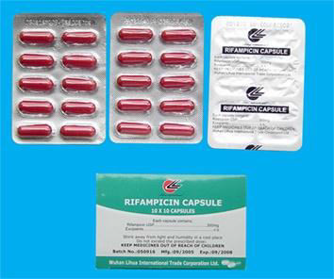
Rifampicin
PK:
• Orally
• Enterohepatic cycling
• T ½ = 1 – 5 hrs
Unwanted effects:
• Hepatotoxicity, GI disturbances, influenza-like
symptoms, skin reactions, eosinophilia, transient
leucopenia, thrombocytopenia, shock, drowsiness,
headache, ataxia, menstrual irregularities, Reddish
coloured urine and tears. Hepatitis or shock-like
syndrome with hepatic involvement

Slide 32
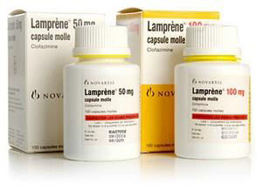
About Clofazimine
Generic Name: Clofazimine
Rated a pregnancy risk category C by the American
Food and Drug Administration

Slide 33
• It is dye
• Antiinflammatory activity
M.O.A:
• Against Leprosy bacilli may involve action on DNA
PK:
• Oral
• 6-7 weeks
• T ½ 8 weeks
ADRs:
• Reddish urination
• Blue – black discoloration of lesions
• Nausea, Giddiness, headache, GI disturbances

Slide 34
Multidrug Therapy for Paucibacillary (PB) Leprosy
 | RFP | Dapsone
Adult 50-70kg | 600mg/m | 100mg/d
Child 10-14 years | 450mg/m | 50mg/d
‘’Less than 10 years’’ | 300mg/m | 25mg/d

Slide 35
Multidrug Therapy for Multibacillary (MB) Leprosy
 | RFP | Dapsone | CLF
Adult 50-70kg | 600mg/m | 100mg/d | 50mg/d &300mg/m
Child 10-14 years | 450mg/m | 50mg/d | 50mg/d & 150mg/m
Less than 10 years | 300mg/m | 25mg/d | 50mg twice/d &100mg/m

Slide 36
Thank you

